Slide 1
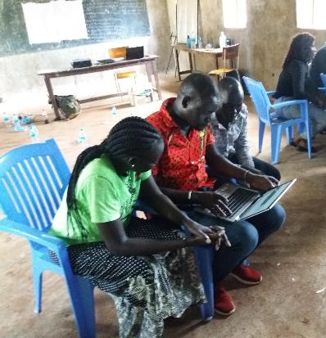
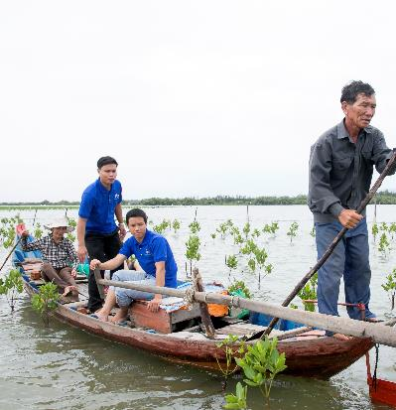
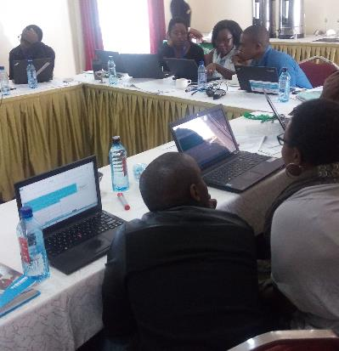
Environmental Stewardship Tool Training (EST)
Please mute mics!
Notes:
Please adapt this presentation to your training needs

Slide 2
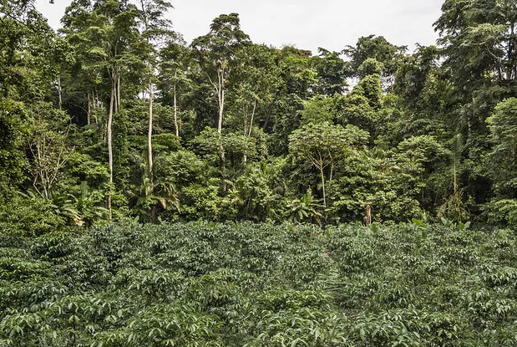
Housekeeping Introductions
off
Technical issues: Harm
Questions: use chat to ask questions.
Will be shared later
Introduce yourself and your role in the chat
Notes:
This is an optional slide in case you are doing an online training

Slide 3
Why are we here ?
While environmental issues affect people all over the world, the poor tend to be most affected by the local consequences of environmental degradation, because they are often more dependent on natural resources for their livelihoods and live in areas susceptible to environmental degradation (Environmental Justice).
The poorest are also disproportionately affected by climate change as a result of their inherent vulnerabilities, high rates of exposure to natural hazards and socio-economic marginalization.
There is a direct link between environmental degradation and climate change as how we treat our natural environment is very much a factor in human induced climate change.
Everything we do has an impact on the environment!

Slide 4
Objectives of the Training
By the end of the session, participants will understand:
Why we promote environmental stewardship in humanitarian, recovery and rehabilitation programs
What the Environmental Stewardship Tool intends to do
When to use the tool
Who should use the tool
How to use the tool
Practice on a real-life scenario
Debrief on the experience & Questions…

Slide 5
What is Environmental Stewardship?
Notes:
Question to participants: Put your comments in the chat or unmute and share

Slide 6
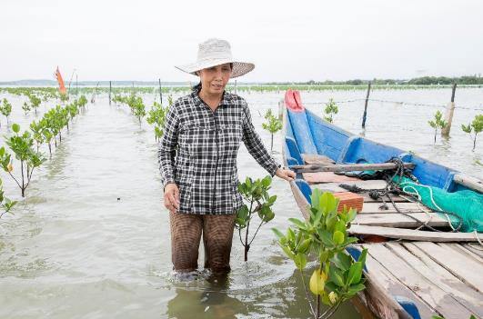
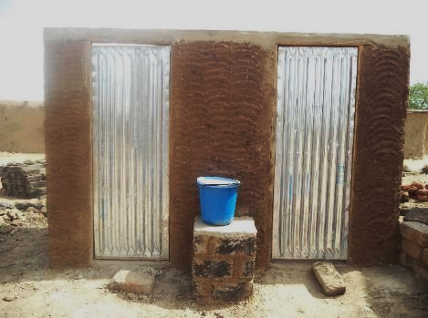
What is Environmental Stewardship?
The sustainable use and management of resources, active restoration activities and actions which result in the positive adaptation of vulnerable communities
Reestablishment of mangrove plantations in Central Viet Nam. Mangroves served to both restore fish populations and act as a natural barrier again storms and storm surge, protecting community assets
Use of local materials for construction of latrine facilities during humanitarian response in Cameroon reduces threat of deforestation
Notes:
Explain that good environmental management can be practiced in any context, from emergency and recovery to longer-term development - this tools was designed to be applied to all those contexts.
The example of Vietnam shows how you can do good for people and planet delivering on environmental outcomes – regenerative model.
Cameroon example shows how we can ‘do no harm’

Slide 7
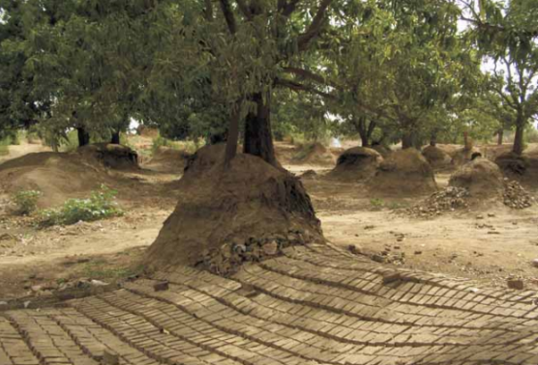
Why Environmental Stewardship?
As practitioners:
Environmental issues can be underlying factors contributing to short- and long-term crises.
Humanitarian and development interventions can also have negative effects on the environment, exacerbate underlying environmental problems, and exacerbate risk and vulnerability.
As Catholic agencies:
Care for Creation – Stewardship is principle in Catholic Social Teaching. Call to respond to the ‘cry of the earth and the cry of the poor’ (Laudato Si)..
Justification - Business Case:
Donor due-diligence increasing on environment.
Compliance and accreditation e.g. Core Humanitarian Standard, Climate & Environment Charter...
Brick production destroys mango grove - Nyala, Sudan (UNEP 2008)
Notes:
Destruction of livelihoods and deforestation due to the production of bricks for humanitarian operations in Darfur.
Dry wells due to excessive drilling by humanitarian organizations in Afghanistan.
Destruction of livelihoods because too many fishing boats were supplied to Sri Lanka after the tsunami, causing depletion of fish stocks.
Failure to meet waste treatment standards that led to environmental contamination in Haiti and the largest cholera outbreak in recent history.
These examples illustrate how humanitarian and peacekeeping actors, by not taking environmental issues into consideration, are defeating their purpose of saving lives and preserving and restoring people's livelihoods

Slide 8
Reflection Exercise In small groups you will discuss:
Think about past projects/activities that may have had negative consequences for the environment
What were they?
What was done about it?
Feedback
Notes:
Optional exercise –

Slide 9
This tool is for you if …
Do you want to ensure you minimize or mitigate against any potential risks to the natural environment as a result of your interventions?
Do you wonder how we (as a sector) can be better stewards of the environment, not only reaping environmental outcomes but leaving the planet in a better place for future generations?
Do you wish to reduce the carbon footprint of your operations?
Do you want to ensure you protect people living in hazard zone areas from the effects of climate change?
Notes:
Hopefully through that discussion you will have noticed that without considering the implications of our work on the natural environment we can actually do harm in the long term – which is particularly important for humanitarians who think and operate in a more immediate timeline . So….

Slide 10
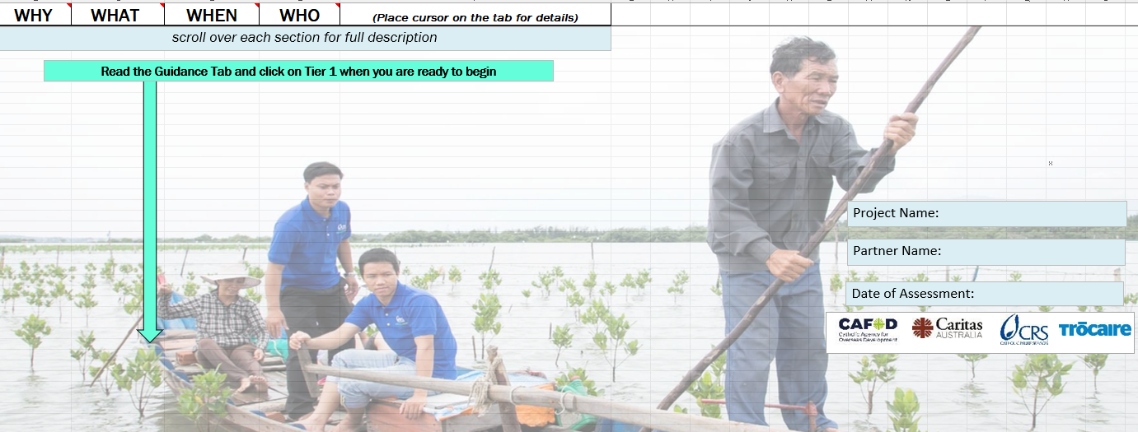
Environmental Stewardship Tool (EST): Background
Finalized in May 2019, developed by Caritas interagency group DRR/Resilience (CRS, CAFOD, Caritas Australia, Trocaire)
3 rounds of review by over 30 CI agency focal points. for DRR, food/livelihoods, protection, shelter/human settlements, water, WASH, as well as project managers, program directors, and MEAL staff
Pilot testing in 6 countries (Australia, DRC, Rwanda, Kenya, India, Indonesia).
Applicable to both humanitarian and development interventions
Review concluded tool is fit for purpose. You are being trained in version 2.0
Notes:
Findings of the EST review affirmed that it is fit for purpose. It can help reduce, mitigate and manage risks. Room for improvement includes guidance on market-based interventions like cash and voucher, operations and CCA integration into FSL guidance

Slide 11
The Environmental Stewardship Tool (EST) - What is it?
An Excel tool Risk register that allows us to consider the threats to the environment resulting from our activities in a specific context. Records the level of "risk" each of these impacts may have (low, medium, and high)
Provides sector-specific guidance on how program activities can mitigate the identified risk: DRR, food security/livelihoods, shelter/human settlements, WASH, Markets & CVA, operations and safe and dignified programming
The tool should be used to facilitate a conversation with the project design team and partners about potential negative environmental impacts and strategies to address them.
Suitable for generalists but enhanced if applied by staff/ partners with technical knowledge (especially for shelter and WASH).
Notes:
Because of our strong partnership model in the Caritas family, we believe in co-designing projects with our partners and supporting their capacity– in that sense this tool really supports you to explore the issue with your partners and the design team.

Slide 12
Limitations of the EST:
It is not an EIA (environmental impact assessment), but potentially a precursor to the EIA process.
It is an internal due diligence tool for environmental risk management and national environmental legislation always needs to be followed.
The EST does not give right or wrong answers, but it does indicate what issues need to be further considered/mitigated.
We do not recommend doing this directly with communities. There is guidance on how to engage communities in the training package (found in the CRS EFOM site).
Notes:
Many donors have accepted this but some have their own tools/ due diligence – you will have to understand what the specific donor needs.

Slide 13
EST: Who uses it, When?
Generally used during the design phase by the design team once the Logframe/DIP/project activities are drafted.
You must have a concrete project (draft CN/ Logframe….) which you are working with to apply this tool.
Programme design team may include, but is not limited to, agency/partner staff (possibly government representatives, community members) or anyone else involved in the design of the intervention.
Estimated time: Between 1.5 and 3 hours depending on the context, complexity and size of the program.

Slide 14
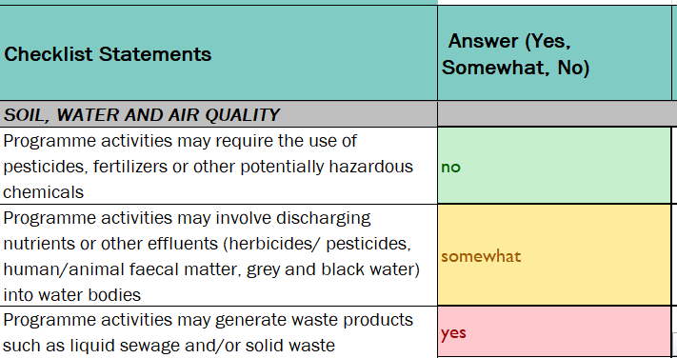
Getting familiar with the tool…
Take some time to get familiar with the tool, focus on looking only at:
Risk Identification (Tier 1)
Risk Profiling (Tier 2)
Final Risk Register and Mitigation/ Regenerative Measure (Tier 3)
Notes:
Statements in tier 1 are crafted as potential risks that may result from the intervention as we are trying to screen for possible risks. If there is a chance, no matter how small that it could have a negative impact, please flag somewhat.
If the statement has no relation to what you're trying to do you can put N/A

Slide 15
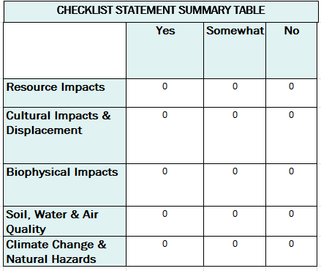
Categories of Impacts (Tier 1)
Impacts on resources
Cultural and displacement impacts
Biophysical impacts
Impacts on soil, water & air quality
Climate change impacts and natural hazards

Slide 16
Tier 2 Risk Profiling and Ranking
This is where you craft the risk statement (with the design team)
Impact Ranking Definitions
High: Complete Disruption for the majority of people in programming area
Medium: Significant problems for roughly 50% of people in the programme area
Low: Moderate to Minor Issues for 25% or fewer of people in programme area
Likelihood Ranking Definitions
High: 75% or above likely to happen
Medium: 26 - 74% likely to happen
Low: 25% or below likely to happen
Tier 2 will give you a risk ranking
Notes:
Once you’ve crafted your risk statement in tier 2 you will have a chance to reflect on the impact and likelihood. Of course these are subjective call, but in discussions with the project design team you can try to come to a consensus.
For instance: your risk statement could be : Irrigation for an agricultural project may deplete water availability for neighboring settlements and downstream users. Impact would be high but likelihoods may be medium / low due to the scale of project.

Slide 17
Excel Cell Number | Checklist Statement Tier 1 | Summary Explanation | Example of Risk Statements Tier 2
A8 | Programme activities may negatively affect downstream users of resources, notably surface and groundwater | Programme activities that would require significant use of a resource, may affect ‘downstream’ users of the source. E.g. intensive agricultural project is abstracting groundwater at high rates, potentially decrease the availability of water for other users in the watershed | Overuse and unregulated use of water for irrigation abstracts groundwater at high rates, leaving other farmers downstream unable to irrigate their crops (this is an important risk to consider in projects that promote cash crop production)
A24 | Programme activities may build structures within 50 meters of a shoreline (e.g. lake, river or sea) | Ensuring proper distance is given relating to construction sites is critical. 50 meters is a common standard, however local regulations may have better information given the conditions on the ground | Shelter construction, along with, placement of irrigation channels, will occur in an area that experiences seasonal tides and could create risk of flooding
A38 | Programme activities and/ or related operations may potentially have additional negative consequences on the natural environment and increase GHG emissions contributing to (long term) climate change | Everything we do has a carbon footprint. Of course, some of it is negligible but we should consider this particularly in regards to the impact of our operations, either directly or indirectly, through the release of greenhouse gases (carbon dioxide, methane, nitrous oxide, hydrofluorocarbons, perfluorocarbons and sulphur hexafluoride) | Diesel generators used as power source in refugee camps will results in increased greenhouse gas emissions, along with high costs
Notes:
These are examples from the ‘support sheet’ which unpacks the statements in tier 1 and offers example of possible risk assessments
The support sheet is found with the other resources in the training package in the CRS EFOM site

Slide 18
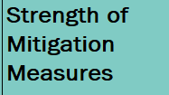
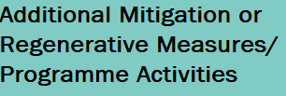
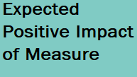
Risk and Mitigation Register (Tier 3)
Risk mitigation table (final product) to be incorporated into final design / activities / work plan
- Automatic from tier 2 :
-
Prioritize what is red and yellow !!!!!
Integrate the results / mitigation measures identified in Tier 3 into project plans/ MEAL/budget
Notes:
Your final product and what you will reintegrate into the project and communicate to donors is the result of tier 3. You will then add this to the final project design. MEAL plans and budget.
If you have no existing mitigation measures already planned, select ‘none’ under strength of mitigation measure. This will leave the net risk ranking blank which means you keep the risk rank from Tier 2.
If you do have some ideas of mitigations already (such as follow SPHERE standards etc…) you should select the strength of the measure (strong, medium, weak). This will give you the net risk ranking and you should come up with mitigation measures for any risks that have a net risk ranking that is yellow or red.

Slide 19
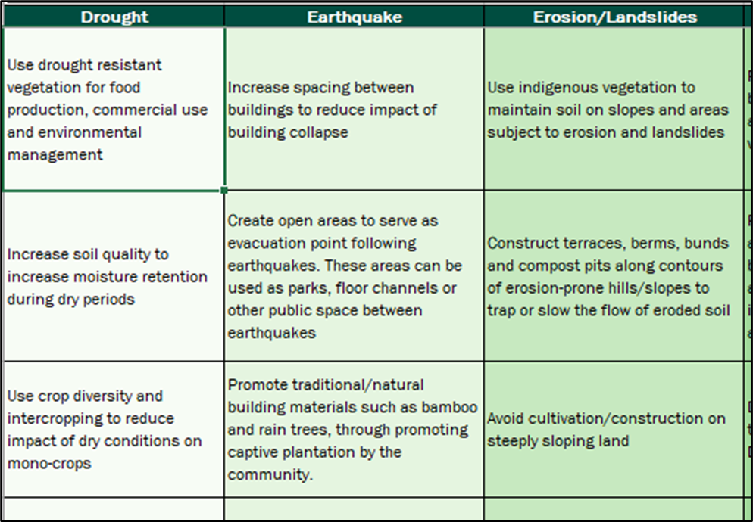
Sector Guidance
Guidance on incorporating environmental stewardship into specific thematic sectors including:
ECO-DRR
Livelihoods/Food Security (CCA)
Shelter and Settlements
WASH
Markets & CVA
Operations
Safe and dignified programming
Notes:
These are general guidelines across the different thematic areas. All guidelines must be adapted to local realities. The tool is not prescriptive, but offers a menu of options and guidance to help craft the mitigation and/or regenerative measures. The tool doesn’t give you right/wrong as everything depends on context/ partner capacity/ budget…
At this point it would be ideal to open the excel and show participants what it is. Or encourage them to open it as you are going through the Tier 1, 2 and 3 slides

Slide 20
Tips for applying the tool:
Some of the statements in Tier 1 may look similar. Our technical experts designed this to probe from different angles. If the same risk is surfacing through different prompts in Tier 1, this is signaling that you have an important risk to mitigate.
It’s ok to have the same risk statement in tier 2 for different prompts and same mitigation measure in tier 3 for that specific risk. What’s important is that you mitigate that risk. If can have more than 1 mitigation measure per risk.
You don’t have to come up with mitigation measures in tier 3 if the risk ranking is low (GREEN), always prioritize the red flags, then orange (net risk rank).
As this is about informing conversation with the design team, and raising awareness in the process, try not to do this alone. The process is as important as the output. Allow plenty of time when doing this with partners.

Slide 21
Tips for applying the tool:
Ideal when activities interface with the environment but can help detect operational issues as well.
Whilst the tool is designed to work as a risk register, you can also go beyond (due no harm) in Tier 3 by considering regenerative practices, such as nature-based solutions.
Mitigation measures identified then need to be integrated back into the project activities and MEAL plans and budget. Similar to any risk matrix.
You should communicate the results to project stakeholders (design team) and potentially donors . Either as part of you regular risk matrix / as its own output accompanied by a brief narrative of the risks identified and related mitigation measures.
Notes:
Final technical tip try not to delete cells. If you need to reuse the EST for another project, open another excel workbook

Slide 22
Exercise: Application of EST to Real Case:
In your programme groups, apply the tool to a real project you are familiar with (existing project or new one):
Pre-select a project to analyse
Check that all group members know the project – provide a brief introduction for those who don’t - share the logframe, activities... Take 10 minutes to get everyone on the same page.
In your groups pick one person to share screen.
Open the Excel
Work together to apply the EST and analyze the project.
Notes:
We highly recommend applying the tool to a real project
Give people at least 2 hours to apply the tool
You can do a 5 hour training:
- 1 hour to introduce this presentation (minimum)
- 2 hours to apply the tool
- At least 1 hour to debrief.
Alternatively, you can do the presentation in the morning, the application of the tool in people’s own time in the afternoon and come back for the debrief the next day. Organise it as you see fit

Slide 23
Debrief
How did the exercise go? Share process
Provide at least 1 example of a risk and related mitigation measure
Do you think you will use the tool in your work?
What particular difficulties do you see in applying the EST in your work?
Notes:
Adjust discussion sessions as needed

Slide 24
Learning from the application of the EST:
This is really about informing conversations with staff and partners.
The application of the tool can surface important capacity strengthening needs.
Sometimes risks may seem to repeat themselves - this is a sign that it is an important risk to consider.
Incorporate mitigation measures into project plans and monitoring (MEAL). Can be used as part of project reflection and monitoring.
Activities that interface with the natural environment (WASH, Shelter, Livelihoods, Agriculture…), seem to benefit most from the process.
Consider mitigation measures that are realistic within the context, capacities, resources. No point in putting something in there that you can’t do.
Notes:
We have found that for some partners, this process has helped inform their capacity strengthening plans.

Slide 25
Learning Continued:
Don’t forget to consider operational impacts eg contribute to GHG emissions such as generator use (Tier 1 Statement A39).
Don't do this alone - working with colleagues/partners is a great way to make them aware of the issues. Raises awareness – ‘eye opening’
Enhances programme quality and can be used for 'due diligence' with donors - demonstrates that you have taken the environment into account. Most importantly it’s about good programming!
Level 3 results help you articulate the measures you are putting in place to mitigate risks – there are budgetary implications.
Make this tool work for you!

Slide 26
Tips for after application of the tool:
Have you integrated the results (Tier 3) of the EST in your project's design and MEAL plan; and adjusted the activities as relevant?
Have you included environmental risks identified through the EST in your general project risk matrix? If relevant, you may consider reporting to donors on this process.
Have you identified specific roles/ functions to action the measures?
Have you clearly identified actions and timelines? Are these realistic? Viable within budget/ time frame?
Have project and partner staff been involved with the application of the EST? Are they aware of the results (tier 3)?
Have you included costs related to identified mitigation measures in the project's budget?
If further training for partners is needed, have you included this in the project’s calendar of activities and budget?
Have you shared/ validated the results with communities? If relevant, you can use the "EST for Communities" guidance to do this.
If desirable, consider applying this tool at base/ mid/ end line to track measures but also identify additional emerging risks.
Notes:
These are found in the ‘guidance’ tab in the tool
If you use the tool again start with a new sheet.

Slide 27
Resources to support the application of the EST
EST excel
PPT to help train others
Brief description of the tool to share with partners/ donors
Support sheet – unpacking the checklist statements
‘Community facing’ EST support sheet
Translation of version 2 will be available in French, Spanish and Arabic
CRS’s EFOM site houses the tool and all resources

Slide 28
Thanks for your interest in the EST

