Slide 1
Module 8: Assigning PSEA Responsibilities
PSEA training of trainers (ToT)
CRS, Humanitarian Response Department (HRD)
Trainer | Date | Location

Slide 2
Module outline
Session 1: PSEA roles and responsibilities for all staff
Session 2: PSEA roles and responsibilities for focal points

Slide 3
Session 1
PSEA roles and responsibilities for all staff

Slide 4
Exercise – World Cafe
Instructions
Staff categories
Brainstorm key roles and responsibilities for each of these categories for PSEA.
Review the previous group’s list and suggest roles and responsibilities that should be added or removed.
3 rounds of 10 minutes each
Table 1 = Managers
Table 2 = HR staff
Table 3 = Board members/senior management
Table 4 = Program staff
Table 5 = All staff (incl support staff such as finance, IT, fundraising, program staff, etc.)

Slide 5
Key PSEA responsibilities (CHS Handbook)
Staff
Adhere to the PSEA Policy and CoC
Managers
Ensure new employees receive PSEA training as part of induction
Report concerns
Participate in an awareness raising session on PSEA
Know their PSEA Focal Point
Ensure PSEA measures are implemented within their area of responsibility
Follow up and address SEA issues appropriately
Board members and/or senior management
Define actions for ensuring PSEA measures are implemented
Regular monitoring of PSEA work
Senior mngt: overall responsibility for ensuring PSEA measures are implemented.
Board members: include an item on PSEA in senior management team meeting agenda
HR Staff
Implement necessary measures when recruiting new staff and volunteers
Ensure all new employees receive a copy of the PSEA policy and code of conduct
Ensure that communities are aware of PSEA Policy and code of conduct and how to report concerns
For program staff:
Build relationships with communities

Slide 6
PSEA roles and responsibilities for all staff – key points
It is essential that all staff understand PSEA is their responsibility.
These responsibilities should be written into job descriptions and included in performance management/appraisal discussions
PSEA is everyone’s responsibility! !!

Slide 7
Session 2
PSEA roles and responsibilities for focal points

Slide 8
PSEA Focal Point - definition
Person or persons within the organization, with a certain level of seniority, responsible for the implementation of the PSEA policy overall, providing staff support with PSEA issues including field visits, and reporting back to the senior management on PSEA issues.

Slide 9
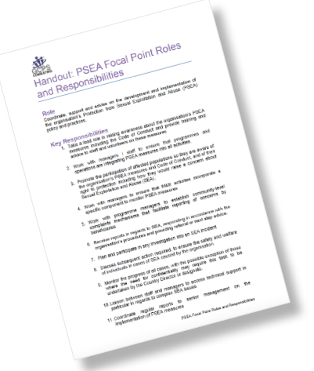
Exercise: PSEA focal points
Part 1. - Go through the handout HO 8.1 PSEA focal point roles and responsibilities and discuss:
What are the key PSEA responsibilities and competencies that are relevant for your context or organization?
Who within your organization will have responsibility for these?
15 minutes
Part 2. Group per organization and Draft the terms of reference (ToR) for one PSEA FP for your context
20 minutes
Part 3. - In plenary brainstorm
Potential challenges that FPs might face
Mitigation measures that they might put in place
20 minutes

Slide 10
PSEA roles and responsibilities for FP– wrap up
All staff have a role and responsibility for PSEA
Certain responsibilities specific to the PSEA FPs
Can be assigned to existing personnel, or new staff
Full time or part-time role
Ideally designate two FPs
Support to PSEA FPs from management/senior leadership vital

Slide 11
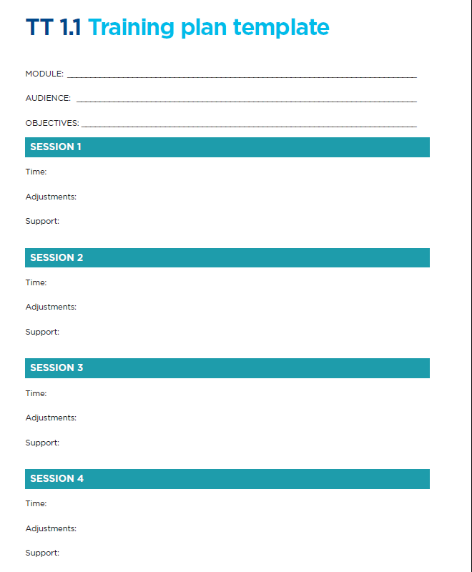
Module review for roll-out
Instructions
Use TT 1.1 training plan template to modify or reflect on the session for the roll-out phase.
Note : this module should be targeting senior leadership and managers within your organization
15 minutes

Slide 12
Thank you!

