Slide 1
Module 7: Responding to SEA Reports (IRIS)
PSEA training of trainers (ToT)
CRS, Humanitarian Response Department (HRD)
Trainer | Date | Location

Slide 2
Module outline
Session 1: Obstacles to staff reporting SEA
Session 4: Investigations
Session 2: Internal reporting
Session 3: SEA reporting from communities

Slide 3
Session 1
Obstacles to staff reporting SEA

Slide 4
Exercise – PSEA Maze Game
Instructions
Everyone has a set of cards, and must start with card Number 1.
On each card, you are presented with a scenario and given options of how to respond. You will be directed to your next card depending on your response.
Please do not scroll through the cards. Follow the numbers based on the instructions on the cards.
Before you begin, please determine if your group will take the role of a female distribution staff member or a male distribution staff member.
20 minutes for the exercise
20 minutes for debrief

Slide 5
Staff obstacles to reporting
Staff can face different challenges in reporting sensitive issues, particularly SEA-related ones.
Staff must be trained on internal reporting systems and encouraged to use
them without fear of retaliation.
Preventing harm
Reacting to stop it
Senior managers have a specific role to raise awareness among staff of internal reporting
Understanding the obstacles for staff to report enables organizations to adjust their PSEA systems.

Slide 6
Session 2
Internal reporting

Slide 7
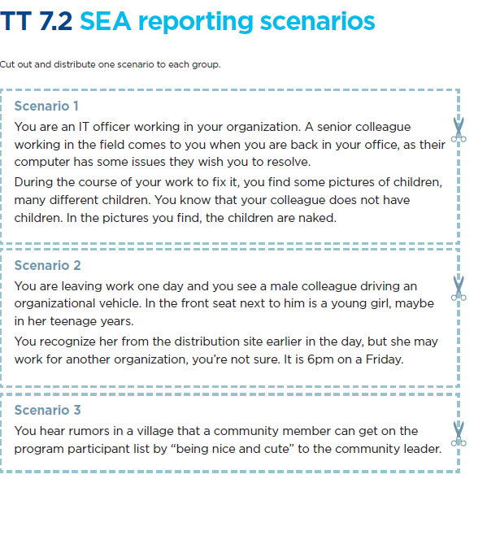
Exercise: Internal reporting channels
Instructions
Discuss the scenario for 10 minutes
Walk to the page that describes your preferred reporting channel for that complaint.
Share what the scenario was and explain:
Why did you choose that reporting channel?
Did you have any concerns?

Slide 8
Internal reporting - escalation process

Slide 9
Escalation process - how different staff should report
General staff
Staff willing to report a case of SEA
Designated channels
Managers
Must report to one of the designated channels
Should inform the reporter of their obligation to escalate
General staff
Staff who receive a complaint from another staff member
Senior management
Manager
Report on your own behalf if witnessed and impacted
Encourage staff to report through appropriate channels or line manager
If staff member or others at risk due of misconduct, report to highest level (i.e. executive director) or use assistance of FP
Designated reporting channels
Focal point/trained staff on sensitive investigation (when available)
Static channel
If you are unsure if it is behavior that should be reported, contact the focal point

Slide 10
Session 3
SEA reporting from communities

Slide 11
Model reporting and escalation procedures for communities

Slide 12
Model reporting and escalation procedures for communities – key points
Remove SEA complaints from FRM
Feedback to victim/survivor or witness provided within 24 hours
Principles of confidentiality and information shared only on a need-to-know basis
Support to the victim/survivor of SEA must take priority
All documents related to the complaint must be kept confidential and securely filed
Investigation & Response Team
Investigation: composed of people regularly conducting investigations
Response: composed of those involved in managing the investigation and reaching conclusions on any necessary disciplinary actions

Slide 13
Exercise: Referral web

Slide 14
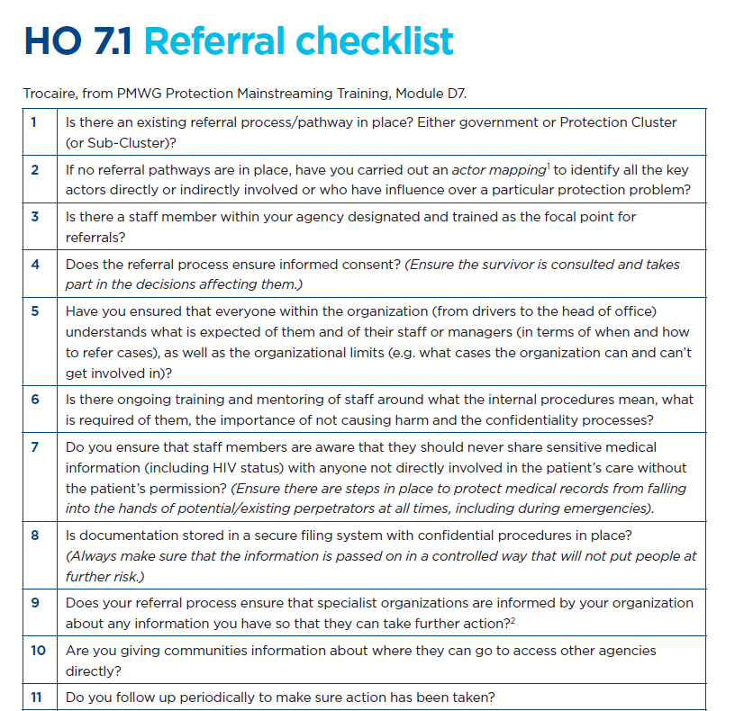
Referral – key points
SEA victims/survivors and those exposed to other forms of harm should not have to continually repeat their story, because it can cause more harm.
Complex processes that involve too many people or result in delays can also cause harm.
Organizations should have clear, simple, accessible, confidential and respectful referral procedures.

Slide 15
Session 4
Investigations

Slide 16
Facilitation practice : Investigation quiz

Slide 17
Facilitation practice : Investigation quiz
When is an investigation required?
There is a rumor of SEA.
There is sensitive feedback received through the FCRM.
A staff member witnessed potential SEA.
Another organization reported SEA in the community we work with.

Slide 18
Facilitation practice : Investigation quiz
Who can conduct an investigation with the organization?
Director
HR department
Project manager
Designated investigation team

Slide 19
Facilitation practice : Investigation quiz
What should be the focus of the investigation?
Finding material evidence that SEA took place.
The alleged perpetrator of the act of SEA.
The safety and security of all involved.
Collecting evidence on code of conduct and policy breaches.

Slide 20
Facilitation practice : Investigation quiz
What are the main roles of the investigation team?
Create an investigation plan.
Gather evidence and corroboration.
Conclude whether policies were breached.
Monitor the safety and security of all parties involved in the investigation.

Slide 21
Facilitation practice : Investigation quiz
What are the main roles of the response team?
To provide support to the investigation team.
To respond to questions from all parties involved.
To inform other team members about the investigation.
To decide on disciplinary actions and corrective measures.

Slide 22
Facilitation practice : Investigation quiz
What does a survivor-centered approach mean?
Deciding the best course of action on behalf of the victim/survivor.
Providing the victim/survivor with information on next steps and respecting their wishes, as far as possible.
Contacting the victim/survivor with updates even if they have expressed a preference for no contact.
Providing information and support for the victim/survivor to access support such as medical, legal, and psychosocial services.

Slide 23
Investigation – key points
Should be conducted by designated and trained staff and independently
Sensitive and non-sensitive complaints handled differently
If enough information is gathered in the follow-up => investigation initiated
Focus on collecting evidence that proves misconduct /breaches of CoC/polices => material evidence of SEA not necessarily
Safety and security of all involved
Confidentiality
Risks for program participants and organizations
Clear mapping and referral process in place

Slide 24
To go further
Guidelines for Investigations (CHS Alliance 2015) (available in French, Spanish and Arabic)
PSEA Task Force: IASC Model Complaints and Investigation Procedures and Guidance Related to Sexual Abuse and Sexual Exploitation

Slide 25
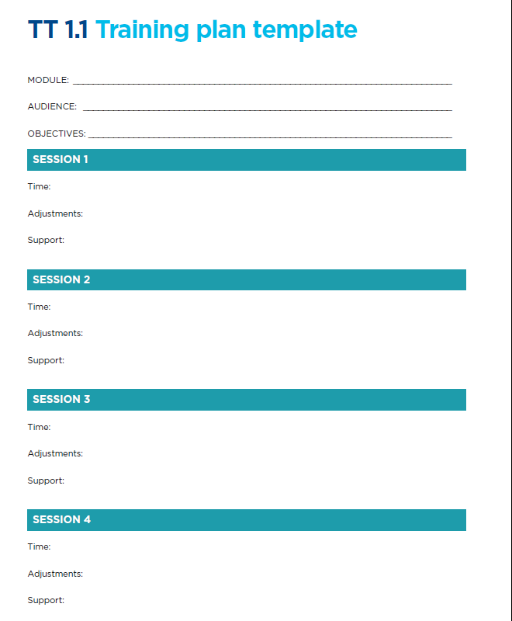
Module review for roll-out
Instructions
Use TT 1.1 training plan template to modify or reflect on the session for the roll-out phase.
Note : this module should be targeting all staff within your organization
15 minutes

Slide 26
Thank you!

