Slide 1
Module 6: Feedback, Complaints and
Response Mechanisms (FCRM) and PSEA
PSEA training of trainers (ToT)
CRS, Humanitarian Response Department (HRD)
Trainer | Date | Location

Slide 2
Module outline
Session 1: Feedback, complaints and response mechanisms and PSEA
Session 2: Handling feedback and complaints
Session 3: Feedback and complaints quiz

Slide 3
Session 1
Feedback, complaints and response mechanisms and PSEA

Slide 4


Exercise (plenary)
Brainstorm : what feedback means and why do we need feedback?

Slide 5
Goal of feedback and complaints mechanism
Improving program quality
Contributing to timely learning
Ensuring the protection of program participants in the programs
Preventing harm
Ensuring learning is considered in decision-making
Reacting to stop it

Slide 6
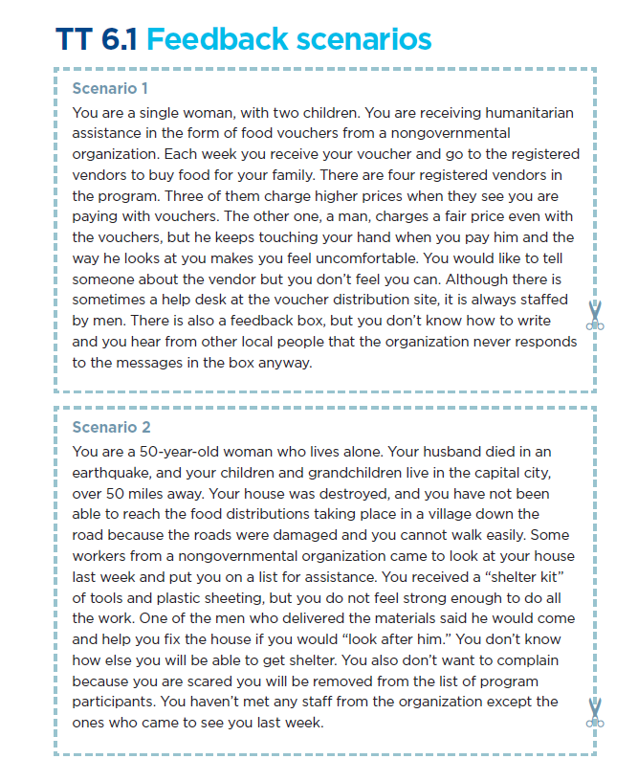

Exercise – Encouraging feedback
Tasks
Discuss two different feedback scenarios TT 6.1
Answers these questions on the flip chart
  What barriers might program participants face when trying to provide feedback, make complaints or report concerns, including those related to SEA?
  What can you do to encourage program participants to provide feedback, make complaints and report concerns, including those related to SEA?
  15 minutes for discussing
  15 minutes to present to the group

Slide 7
Barriers to giving feedback
Fear of losing access to services, reprisals..
Fear of not being taken seriously
Fear of senior official
Not seen as acceptable practice in country/region
Not seen as acceptable to challenge those in authority
Lack of knowledge of the right to report or how to report
Lack of access to feedback channel
Inappropriate choice of feedback mechanism
Belief that nothing will change
Embarrassment or shame

Slide 8
Ways to encourage participants to report
Foster engagement with diverse groups
Multiple feedback mechanisms
Better communication on how + what to report, appropriate/inappropriate behavior
Better or quicker response to feedback and complaints
Strong procedures to ensure the confidentiality and safety of complainants
Better communication on how feedback is acted upon
Stronger community engagement
Diversity of staff to

Slide 9
Encouraging feedback – key points
Trust is essential for feedback and complaint system to be successful.
Organizational culture in which complaints are taken seriously and acted upon is essential
Communities aware on what behavior is acceptable and how to complain
Sensitive complaints must be dealt with promptly and safely.

Slide 10
Minimum PSEA messages for communities relevant to feedback and complaints
Definition of sexual exploitation and abuse
Standards of conduct for aid workers
Right to free assistance
Where and how to report SEA incidents
What services are available, and how to access them
What to expect after making a complaint (incl. referrals, timeframes, roles, responsibilities, any limitations)
What steps the organization will take to ensure safety and confidentiality

Slide 11
Session 2
Handling feedback and complaints

Slide 12
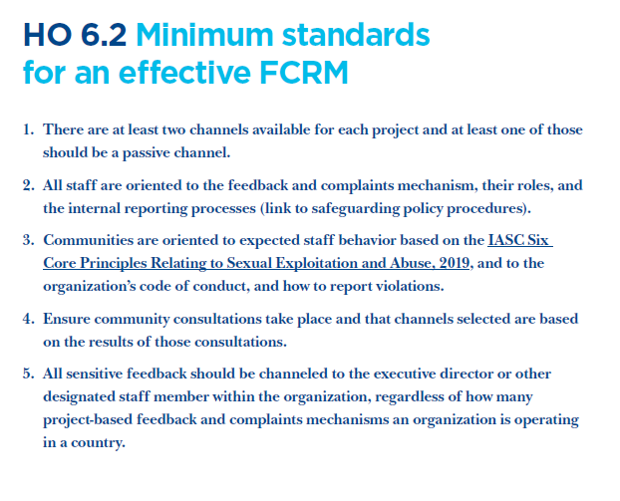
5 minimum standards for FCRM
There are at least two channels available for each project and at least one of those should be a passive channel.
All staff are oriented on the feedback, complaints and response mechanism, their roles and the internal reporting processes
Communities are oriented on the Six Core Principles of staff behavior and the code of conduct, and how to report violations.
Ensure community consultations take place and that channels selected are based on the results of those consultations
All sensitive feedback should be channeled to the executive director or other designated staff member within the organization

Slide 13
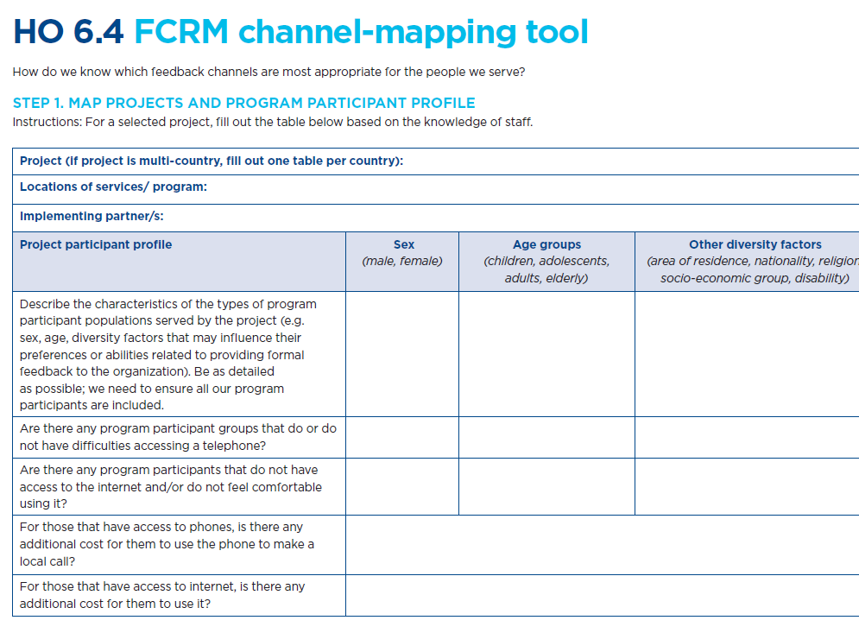
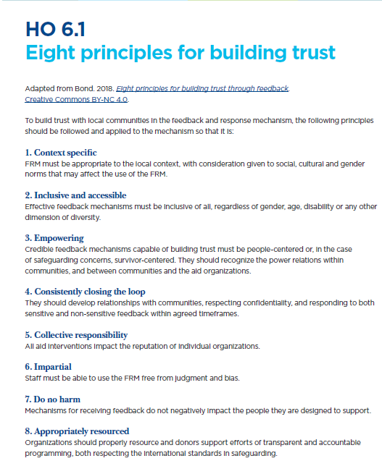
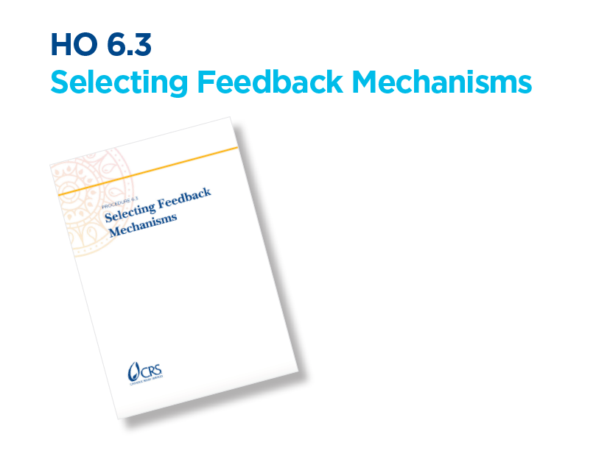
Effective FCRM – additional tools
HO 6.3 Selecting feedback mechanisms
HO 6.4 FCRM channel-mapping tool
HO 6.1 Eight principles for building trust

Slide 14





Facilitation practice : 12 complaints handling steps
Instructions
Put the 12 cut out steps into the right order
15 minutes

Slide 15
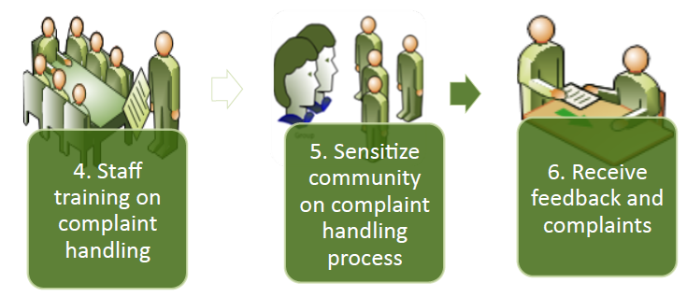
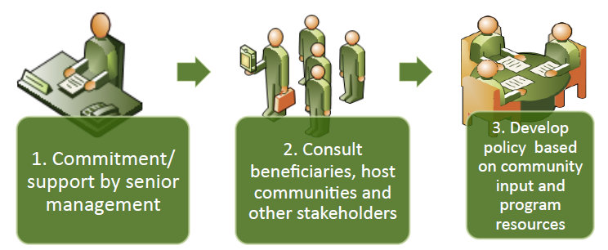
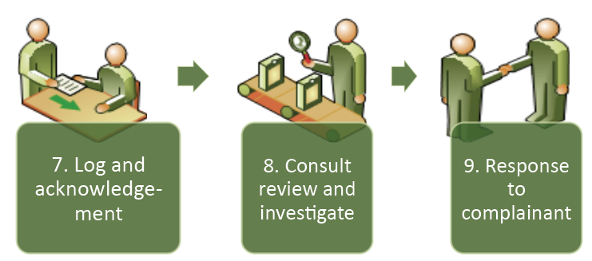
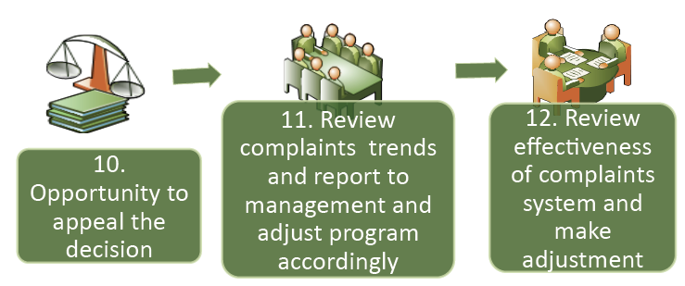
Facilitation practice : 12 steps for handling feedback amd complaints

Slide 16


Exercise – processing sensitive and non sensitive feedback and complaint
Tasks
6. Receive feedback and complaints
7. Log and acknowledgement
8. Consult, review and investigate
9. Response to complainant
10. Opportunity to appeal the decision
11. Review complaints trends, report to management and adjust program accordingly
12. Review effectiveness of complaints system and make adjustments
Use the last seven steps from HO 6.5 Twelve complaints-handling steps.
Identify how would you manage each of the two feedbacks received based on the last seven steps or the handout
20 minutes for the exercise
15 minutes to present to the group

Slide 17
Processing sensitive and non sensitive feedback and complaint
Non-sensitive feedback/complaint
Sensitive feedback/complaint
Might be received by project staff, BUT should be forwarded to senior management for further handling
If SEA, PSEA focal point should be involved
Shared with management for decision if needed
Received by project staff
Shared back with communities
Feedback to the complainant should be done individually
Should never be share publicly
Immediate support to the victim/survivor depending on the circumstances (medical support, transfer to a safe location, etc.)
Not always possible to guarantee confidentiality (e.g. mandatory reporting laws)

Slide 18
Response time
Sensitive feedback should be acted upon immediately, receipt acknowledged, and
the handling process initiated.
Non-sensitive feedback should be responded to within two weeks.

Slide 19
Closing the Loop

Slide 20

Closing the Loop
Always thank the person giving feedback for sharing their opinion.
Let them share preferred medium for receiving an answer:
  individual (phone call, SMS, home visit)
  public (public address, poster)
Closing the loop particularly important for sensitive feedback, due to sensitivity of and consequences if no action taken.

Slide 21
DO’S
Do clearly explain to the community member what happens with the feedback that is collected.
Do ask for consent to take the person’s details (people don’t have to give personal details such as names etc. But if they prefer to stay anonymous, they need to be informed that this means we cannot get back in touch with them directly).
Do listen carefully to what the person has to say.
Do empathize with the person.
Do document the feedback thoroughly (think of the questions: What happened? Who was involved? Where and When did it happen?).
Do repeat the feedback back to the person to ensure you understand the situation.
DON’TS
Don’t become defensive.
Don’t push people to give you details they don’t want to share.
Don’t argue with the person.
Don’t be dismissive.
Don’t blame others.
Don’t make assumptions without knowing the facts.
Don’t make promises you can’t keep.
Don’t ignore the problem.

Slide 22
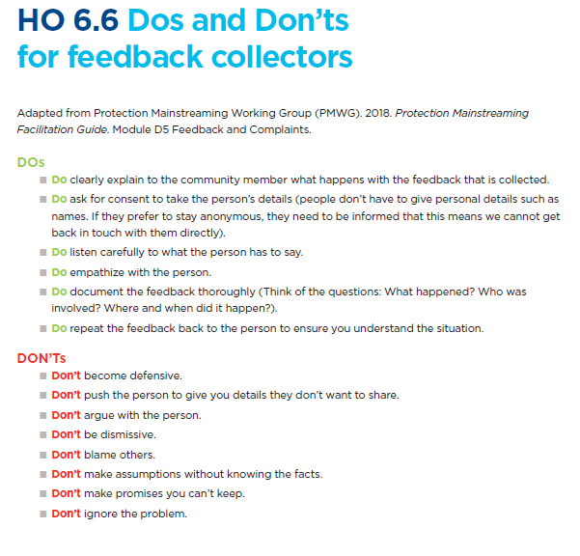
DO’s and DON’Ts for Feedback collector
Do’s
Don’t
Do clearly explain to the community member what happens with the feedback that is collected.
Do ask for consent to take the person’s details (people don’t have to give personal details such as names etc. But if they prefer to stay anonymous, they need to be informed that this means we cannot get back in touch with them directly).
Do listen carefully to what the person has to say.
Do empathize with the person.
Do document the feedback thoroughly (think of the questions: What happened? Who was involved? Where and When did it happen?).
Do repeat the feedback back to the person to ensure you understand the situation
Don’t become defensive.
Don’t push people to give you details they don’t want to share.
Don’t argue with the person.
Don’t be dismissive.
Don’t blame others.
Don’t make assumptions without knowing the facts.
Don’t make promises you can’t keep.
Don’t ignore the problem

Slide 23
Session 3
Feedback and complaints quizz

Slide 24

Facilitation practice : Feedback and complaint Quiz

Slide 25
Facilitation practice : Feedback and complaint Quiz
Feedback is any information shared by the program participants or community to my organization, and by my organization back to program participants or community.
=> Agree

Slide 26
Facilitation practice : Feedback and complaint Quiz
A complaint can be positive or negative.
=> Disagree

Slide 27
Facilitation practice : Feedback and complaint Quiz
Feedback has to be received through formal systems.
=> Disagree

Slide 28
Facilitation practice : Feedback and complaint Quiz
Feedback is accepted only if it is about our program.
=> Disagree

Slide 29
Facilitation practice : Feedback and complaint Quiz
We can ignore certain feedback.
=> Agree and Disagree

Slide 30


To go further
Guidelines for Investigations (CHS Alliance 2015) (available in French, Spanish and Arabic)
Closing the Loop: Effective feedback in humanitarian contexts (Bonino 2014).

Slide 31
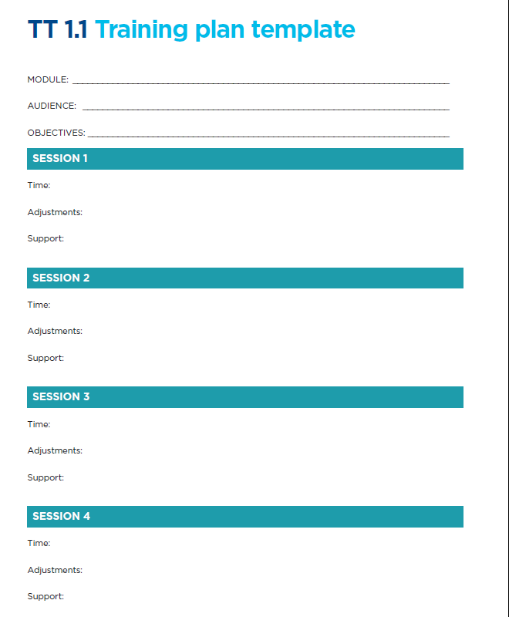
Module review for roll-out
Instructions
Use TT 1.1 training plan template to modify or reflect on the session for the roll-out phase.
Note : this module should be targeting senior leadership and managers with their organizations as well as staff handling feedback
15 minutes

Slide 32
Thank you!

