Slide 1
Module 4: Developing PSEA Human Resources Policies and Measures
PSEA training of trainers (ToT)
CRS, Humanitarian Response Department (HRD)
Trainer | Date | Location

Slide 2
Module outline
Session 1: Staff and PSEA
Session 2: HR PSEA Measures

Slide 3
Session 1
Staff and PSEA

Slide 4
PSEA staff awareness – what needs to be in place?
Strategy around raising staff awareness on PSEA
Initiated and promoted by senior leadership and management
Staff awareness-raising plan
Resource planning and capacity building plan

Slide 5
PSEA staff awareness – Practical steps
Sign Code of Conduct
PSEA Induction and refresher
PSEA responsibilities in JDs & performance review
Staff aware of their obligation to report
Include PSEA in regular staff meetings
PSEA information materials displayed

Slide 6
Session 2
HR PSEA Measures

Slide 7
Exercise (plenary)
Brainstorm : why HR plays such an important role in PSEA?

Slide 8
Why do we need to address HR processes in the light of PSEA?
SEA incidents and staff behavior
Right staff for the right position at the right time
PSEA responsibilities in JDs and performance review
PSEA responsive HR policies = SEA prevention
PSEA elements in staff hiring processes

Slide 9
PSEA measures on staff recruitment and vetting
Job adverts include PSEA commitments
Gaps in employment history checked during interview
PSEA questions asked during interview
At least two references from previous employers
Criminal records check is conducted, where possible
New employees sign contracts which include PSEA and organization's code of conduct

Slide 10
Exercise – Job advertisement and Interview
Group 1
Group 2
Discuss the job advertisement for a position of a Shelter Program Officer in a refugee camp with 30% of time allocated to a Child Friendly Space (CFS).
Task: share the details of the job advertisement
20 minutes to prepare
5 minutes to present in plenary
Roll play a job interview with three panelists (HR manager, project manager and PSEA focal point) and one candidate for the position of a Protection Officer in a refugee camp, with 30% of time allocated to Child Friendly Spaces (CFS).
Task : select panelists and develop at least 5 interview questions.

Slide 11
HR measure 1 : Job advertisement
Make a clear commitment to PSEA by including a sample statement
Include key values, i.e. as honesty, respect, diversity, accountability, etc.
Include statements on candidate’s motivation, i.e.. “We are looking for people who are values led and results driven.”
Include organizational principles: neutrality, impartiality, humanity and independence
Example :The organization requires its staff to treat all people with dignity and respect, actively prevent harassment, abuse, exploitation, human trafficking everywhere and at all times”

Slide 12
HR measure 2: Job interview
Key recommendations
Debriefing
For positions involving direct contact with vulnerable program participants => Panel to include hiring manager + HR person + PSEA focal point (ideally)
Interviewers should have relevant experience and knowledge of PSEA/safeguarding
Discuss policies around staff / program participant relations
Review generic and role-specific interview questions from handout

Slide 13
Exercise – Active Reading and Teaching – PART 1
Task
Five PEAS measures
Job descriptions
Gender-balanced recruitment
Gaps in employment history
Background checks and references
All staff sign contracts that include PSEA elements and the organization’s Code of conduct
In each group one participant should read one of the PSEA measures from HO 4.2 and present what their measure is about.
5 minutes for reading
5 minutes to present to the group

Slide 14
Exercise – Active Reading and Teaching – PART 2
Discuss in you organizational teams
which measures are already in place?
which need strengthening, and how that can be done?
Teams from each organization to share with the wider group.
10 minutes for team discussion and
5 minutes for each organization to share within the group

Slide 15
HR Measure 3 - Job Description
Include overview responsibilities/competencies
Serves as basis for staff performance appraisals
Direct work with vulnerable groups, especially children = soft competencies
ALL JDs to include commitments to Safeguarding/PSEA

Slide 16
HR Measure 4 - Gender balanced recruitment
Strive - gender-balance
No limitations of the candidate pool
Job posting strategy not limited to online platforms
Input from male + female staff on diverse candidate
Job advr attract a wider pool of female candidate
Hiring committee- male + female
Properly emphasize non-technical competencies
Do not ask female candidates if they plan to have kids
Flexibility in the reference process is suggested
Salary internal audits to avoid gender pay gaps

Slide 17
HR Measure 5 - Gaps in employment history
Obtain more information about any gaps in employment history by asking:
How was time in between jobs spent?
Specifically ask if they did any volunteer or community work. Ask for references (names and contacts) from those engagements as well

Slide 18
HR Measure 6 - Background checks and references
References gathered
CONCERNS - Communicate and record in writing
Background checks
Written consent
Declaration statement
Concerns + further information.
Reference check procedure at all times!

Slide 19
HR Measure 7 - Signed CoC and contracts include PSEA
All staff contracts include the statement of understanding and adhering to the Code of Conduct.
All staff contracts include IASC Six Core Principles Relating to Sexual Exploitation and Abuse
Code of Conduct includes the same principles to a minimum
All staff contracts include organizational values, mission and vision
All signed documents are kept on personnel files

Slide 20
Wrap up - PSEA HR Measures
Also include staff onboarding/training on PSEA => see module 7
Key role of HR managers and senior managers/leadership
Local laws to be taken into consideration when vetting staff.
Requires close coordination between managers/HR staff/PSEA FPs
HR Policy defining roles/responsibilities/tools for HR PSEA measures

Slide 21
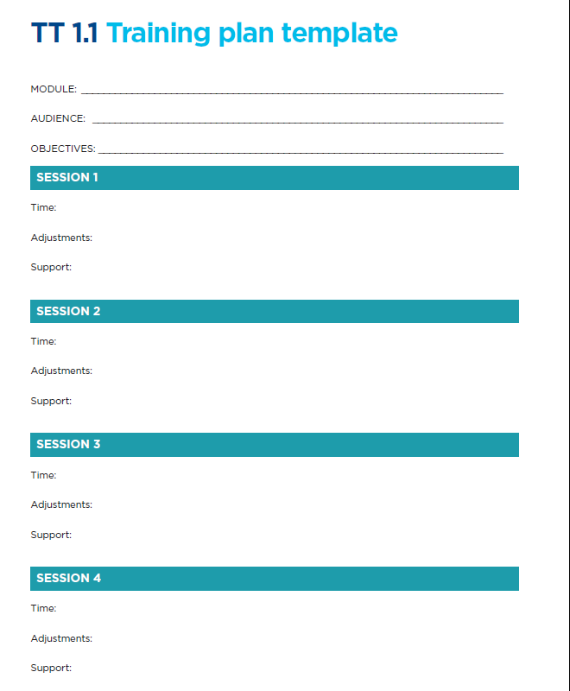
Module review for roll-out
Instructions
Use TT 1.1 training plan template to modify or reflect on the session for the roll-out phase.
Note : this module should be targeting senior managers and HR staff within your organization
15 minutes

Slide 22
Thank you!

