Slide 1
Module 3: Developing PSEA Policy and Code of Conduct (CoC)
PSEA training of trainers (ToT)
CRS, Humanitarian Response Department (HRD)
Trainer | Date | Location

Slide 2
Module outline
Session 1: PSEA policy
Session 2: Code of Conduct (CoC)

Slide 3
Session 1
PSEA policy

Slide 4
PSEA policy - CHS Alliance key recommendations
Identifies organization's commitment to the 2003 UN SG Bulletin on PSEA
Recognizes rights of all beneficiaries to be protected from SEA
Identifies and manages risk
Includes the organization's Code of Conduct.
Integrates PSEA measures into all areas of the organization
Applies to all staff, volunteers and associates at all times

Slide 5
Exercise – Key actions
DISCUSS
GROUP key actions under these headings :
What are the key actions are that you could identify for a policy in your organizations?
HR
Whistleblowing
Safe and dignified programming
Partnership arrangements
Complaints/reporting
Investigations and survivors’ assistance

Slide 6
Procedures supporting PSEA policy
HR
Recruitment
Whistleblowing
Protect staff and promote SEA reporting
Induction/training
Performance management
Discipline and grievance
Safe and dignified programming
Partnership arrangements
Ensure compliance with PSEA policy
Complaints/reporting
Investigations and survivors’ assistance
For own staff
For community members
Identify and mitigate risks in programs
Protect beneficiaries and promote SEA reporting

Slide 7
Wrap up Session 1: PSEA policy
Way for setting out expectations about behavior of staff and associates
Responsibility of senior leadership and management
Should be designed through consultative process
Procedures to describe how the policy will be implemented required.

Slide 8
Session 2
Code of Conduct (CoC)

Slide 9
Exercise – Code of Conduct Scenarios
Instructions
Code of conduct breaches
Read through the TT 3.1 Examples of code of conduct breaches and HO 1.2 IASC Six Core Principles
Identify breaches of the Six Core Principles
Has the code of conduct been breached?
If so, what rule has been broken?
What would your first step be?
15 minutes for the exercise
5 minutes to present in plenary
A male team member comments on a “pretty girl” in a distribution line.
There are rumors of a project staff member adding the name of his girlfriend to the list of project participants.
A project participant in your shelter project is told she must have sex with a contracted carpenter in order to get her roof fixed.
A male volunteer meets a 16-year-old female project participant in a bar for a drink and takes her to his house for sexual intercourse.

Slide 10
Facilitation practice : Code of Conduct Quiz

Slide 11
Facilitation practice : Code of Conduct Quiz
Why is a code of conduct necessary?
To safeguard program participants from staff misconduct
To protect staff from false allegations
To demonstrate compliance with donor requirements
To address ethical issues
All the above

Slide 12
Facilitation practice : Code of Conduct Quiz
Who does the code of conduct apply to?
Only the organization’s employees with signed contracts
Volunteers and affiliates
All staff, volunteers and associates at all times

Slide 13
Facilitation practice : Code of Conduct Quiz
How are the principles and values of the code of conduct put into practice?
All staff understand what misconduct entails, including possible disciplinary measures
All staff receive onboarding and refresher trainings on the CoC
All the above

Slide 14
Facilitation practice : Code of Conduct Quiz 4/X
Who is responsible for defining and promoting the values and principles of the CoC throughout the organization?
Senior management have a particular role in ensuring that all staff understand and adhere to the code
Field staff, since they are in direct contact with program participants
Donors, as they are responsible for seeking compliance with the CoC

Slide 15
Facilitation practice : Code of Conduct Quiz
If staff observe or suspect breaches of the code of conduct, they should:
Not get involved as there are other designated staff within the organization to address these issues
Share their suspicion with their trusted colleagues
Report only if they don’t have a good relationship with the colleague involved
None of the above

Slide 16
Facilitation practice : Code of Conduct Quiz
What is a proportional disciplinary measure if a staff member is found to have breached one of the Six Core Principles within the CoC?
A warning letter
Unpaid suspension from work for 6 months
Termination of contract
Mandatory PSEA refresher course

Slide 17
Facilitation practice : Code of Conduct Quiz
What should the code of conduct consist of?
Organizational vision and mission
Prohibitions on sexual harassment, abuse and exploitation
Prohibitions on trafficking
IASC Six Core Principles at a minimum

Slide 18
Facilitation practice : Code of Conduct Quiz
When does the code of conduct apply?
When staff are working directly with program participants
In emergency interventions
During office hours for all staff
At all times

Slide 19
Facilitation practice : Code of Conduct Quiz - Key messages
Define employee behaviors
Safeguard and protect program participants & organizations
Staff behaviors formally addressed
IASC 6 Core Principles
Must be signed by ALL staff, volunteers, affiliates
Individual choice

Slide 20
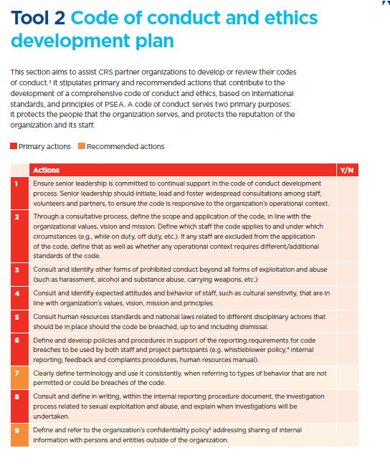
Exercise – review code of conduct content
Instructions
Review your organization’s Code of Conduct using Tool 2 Code of conduct and ethics development plan
15 minutes

Slide 21
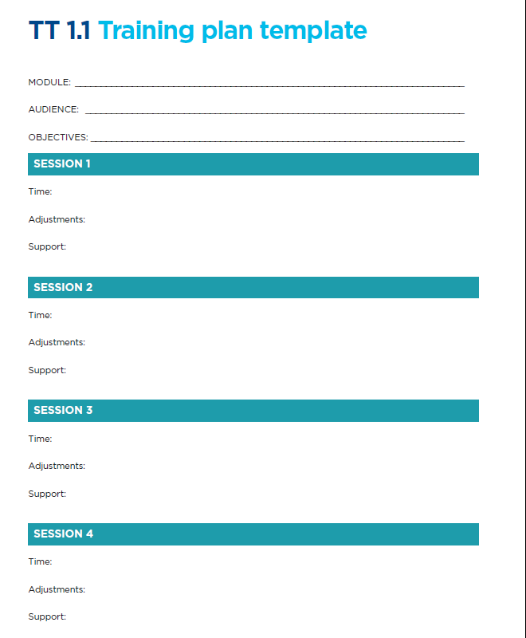
Module review for roll-out
Instructions
Use TT 1.1 training plan template to modify or reflect on the session for the roll-out phase.
Note : this module should be targeting senior leadership and managers within your organization
15 minutes

Slide 22
Thank you!

