Slide 1
Module 2: PSEA and Safe Programming
PSEA training of trainers (ToT)
CRS, Humanitarian Response Department (HRD)
Trainer | Date | Location

Slide 2
Module outline
Session 1: Understanding safe programming
Session 2: Identifying protection and SEA risks
Session 3: Mitigating protection and SEA risks

Slide 3
Session 1
Understanding safe programming

Slide 4
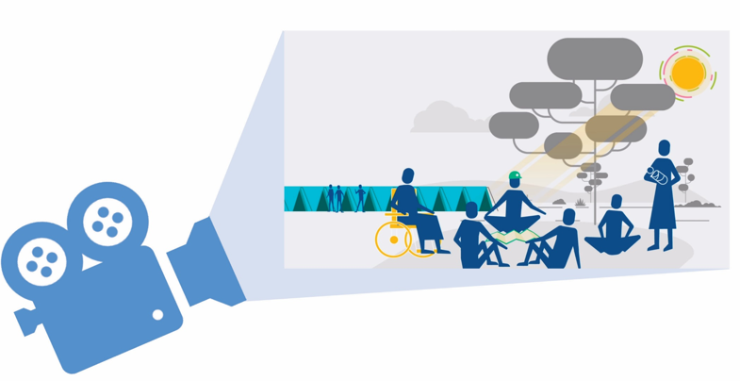
Exercise : Protection Mainstreaming video

Slide 5
Exercise – video
What is your own experience of integrating safe programming or protection mainstreaming into your work?
How does your experience relate to the eight components of the protection mainstreaming framework?
Analysis
Targeting and diversity of need
Information sharing
Community engagement
Feedback and complaints mechanisms
Staff conduct
Mapping/ Referral
Coordination/Advocacy

Slide 6
What is Safe Programming?
Safe programming is about increasing safety, dignity and access.
All staff have a role to play in safe programming.
Safe programming focuses not on what we do, but how we do it.
Safe programming is also known as Protection mainstreaming
One approach to safe programming is outlined in the protection mainstreaming framework that consists of eight core components. These are practical actions that teams can take.

Slide 7
Exercise - Links between PSEA / safe programming
.
What key actions can be taken to minimize and address SEA?
Task
Match the framework components cards with the appropriate list of actions that can be taken to minimize and address SEA
Core components of Protection Mainstreaming
Mapping / Referral
Targeting + Diversity of Needs
Analysis
Coordination / Advocacy
Staff Conduct
Feedback and Complaints
Mechanisms
Community Engagement
Information Sharing
Safety & Dignity
Meaningful access
Accountability to beneficiaries
Participation & Empowerment

Slide 8
Links between PSEA and safe programming
Safe programming measures can help reduce people’s vulnerability to exploitation and abuse in general and more specifically to SEA by staff and personnel
Safe programming involves putting measures in place to prevent and respond to the harm caused by staff and programs.
By building trust in programs, engaging communities, and responding to programmatic feedback, you also build up confidence of people to report sensitive issues.

Slide 9
Exercise – Case study
You are making a routine monitoring visit to a program site and you check in with the team on the help desk to see what feedback is coming in. There is not much to report but, as you are observing activities, a team member tells you that earlier that day a woman came to speak to her. She told the team member that in order to access the
program services, she was forced to have sexual intercourse with a staff member of your organization. She said that the staff member said he would deliver the goods, as she was unable to carry them the long distance to her home, and when he came to her house he raped her. (This is a real case from Mozambique)
Question: What immediate actions do you take?

Slide 10
Wrap up Session 1: Understanding safe programming
Safe programming is also known as Protection mainstreaming
One approach to protection mainstreaming is outlined in the protection mainstreaming framework that consists of eight core components.
Safe programming is about operationalizing PSEA at the program level – it is about the practical actions staff can take to minimize and address the harm caused by staff and programs.

Slide 11
Session 2
Identifying protection and SEA risks

Slide 12
Exercise – Bubble Analysis PART 1
Instructions
Examples from the Philippines
Read through the Protection risks (TT 2.2 )
Select three to five of the most important risks per category (i.e. GBV, child protection).
Draw three to five bubbles on a flip chart

Slide 13
Wrap up Session 2: Identifying protection and SEA risks
Assess the context in which the program is to take place – identify the general risks and issues related to sexual exploitation and abuse in communities is essential.
Analysis of the context (including protection risks) should inform decision-making and should be regularly updated.
Communities experiencing abuse and exploitation are also more vulnerable to it being perpetrated by staff and associated personnel, and those contracted to deliver program.

Slide 14
Session 3
Mitigating protection and SEA risks

Slide 15
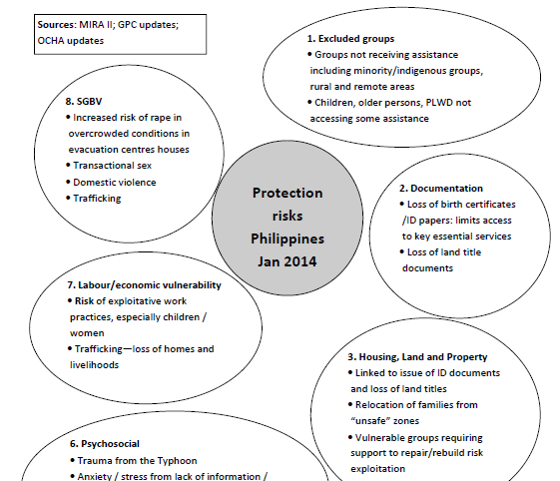
Exercise – Bubble Analysis PART 2
Could the project increase/exacerbate the SEA risks by staff and associated personnel?
Could you think of mitigation measures/strategies?
For example, if sexual exploitation is a risk for older female households in shelter programs consider providing additional labor to help them repair/rebuilt their shelter.
Did you face any challenges in doing so (budget, organizational barriers, donor requirements etc.)? If so, hold did they address them?
This is SAFE PROGRAMMING !!

Slide 16
Wrap up Session 3: Mitigating protection and SEA risks
Program participants who desperately need goods and services will be more vulnerable to exploitation.
Adapt, or redesign, any program/project that is presenting a risk of SEA by staff or associated personnel is essential.

Slide 17
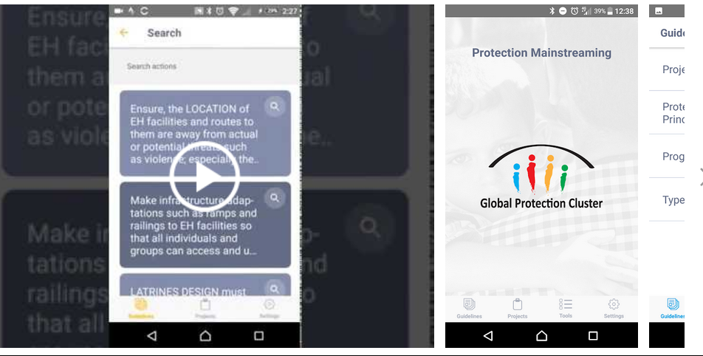
To go further : Additional resources
“Protection Mainstreaming Framework”, PMWG
“Guidance Note: How to do Bubbles Protection Analysis”, PMWG
“Guidance Note: How to Incorporate Protection Mainstreaming in Project Designs and Funding Proposals”, PMWG
“Protection Mainstreaming Monitoring, Evaluation and Learning Toolkit”, PMWG
Protection Mainstreaming Sector Checklists (Shelter, WASH, Cash, Safe Distribution, etc.), PMWG
CRS EFOM https://efom.crs.org/
Protection Mainstreaming APP : https://www.globalprotectioncluster.org/_assets/files/presentation-pm-app.pdf

Slide 18
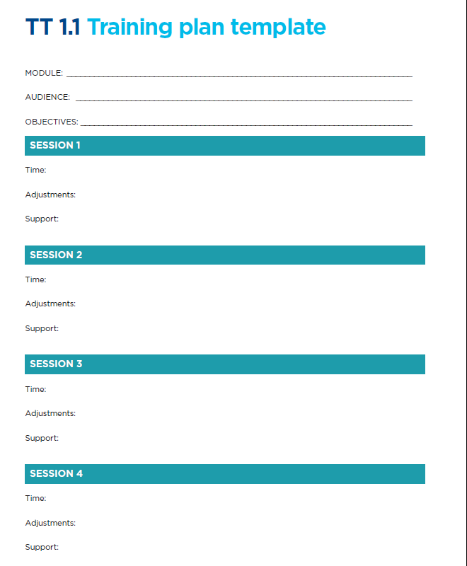
Module review for roll-out
Instructions
Use TT 1.1 training plan template to modify or reflect on the session for the roll-out phase.
Note : this module should be targeting all program staff.
15 minutes

Slide 19
Thank you!

