Slide 1
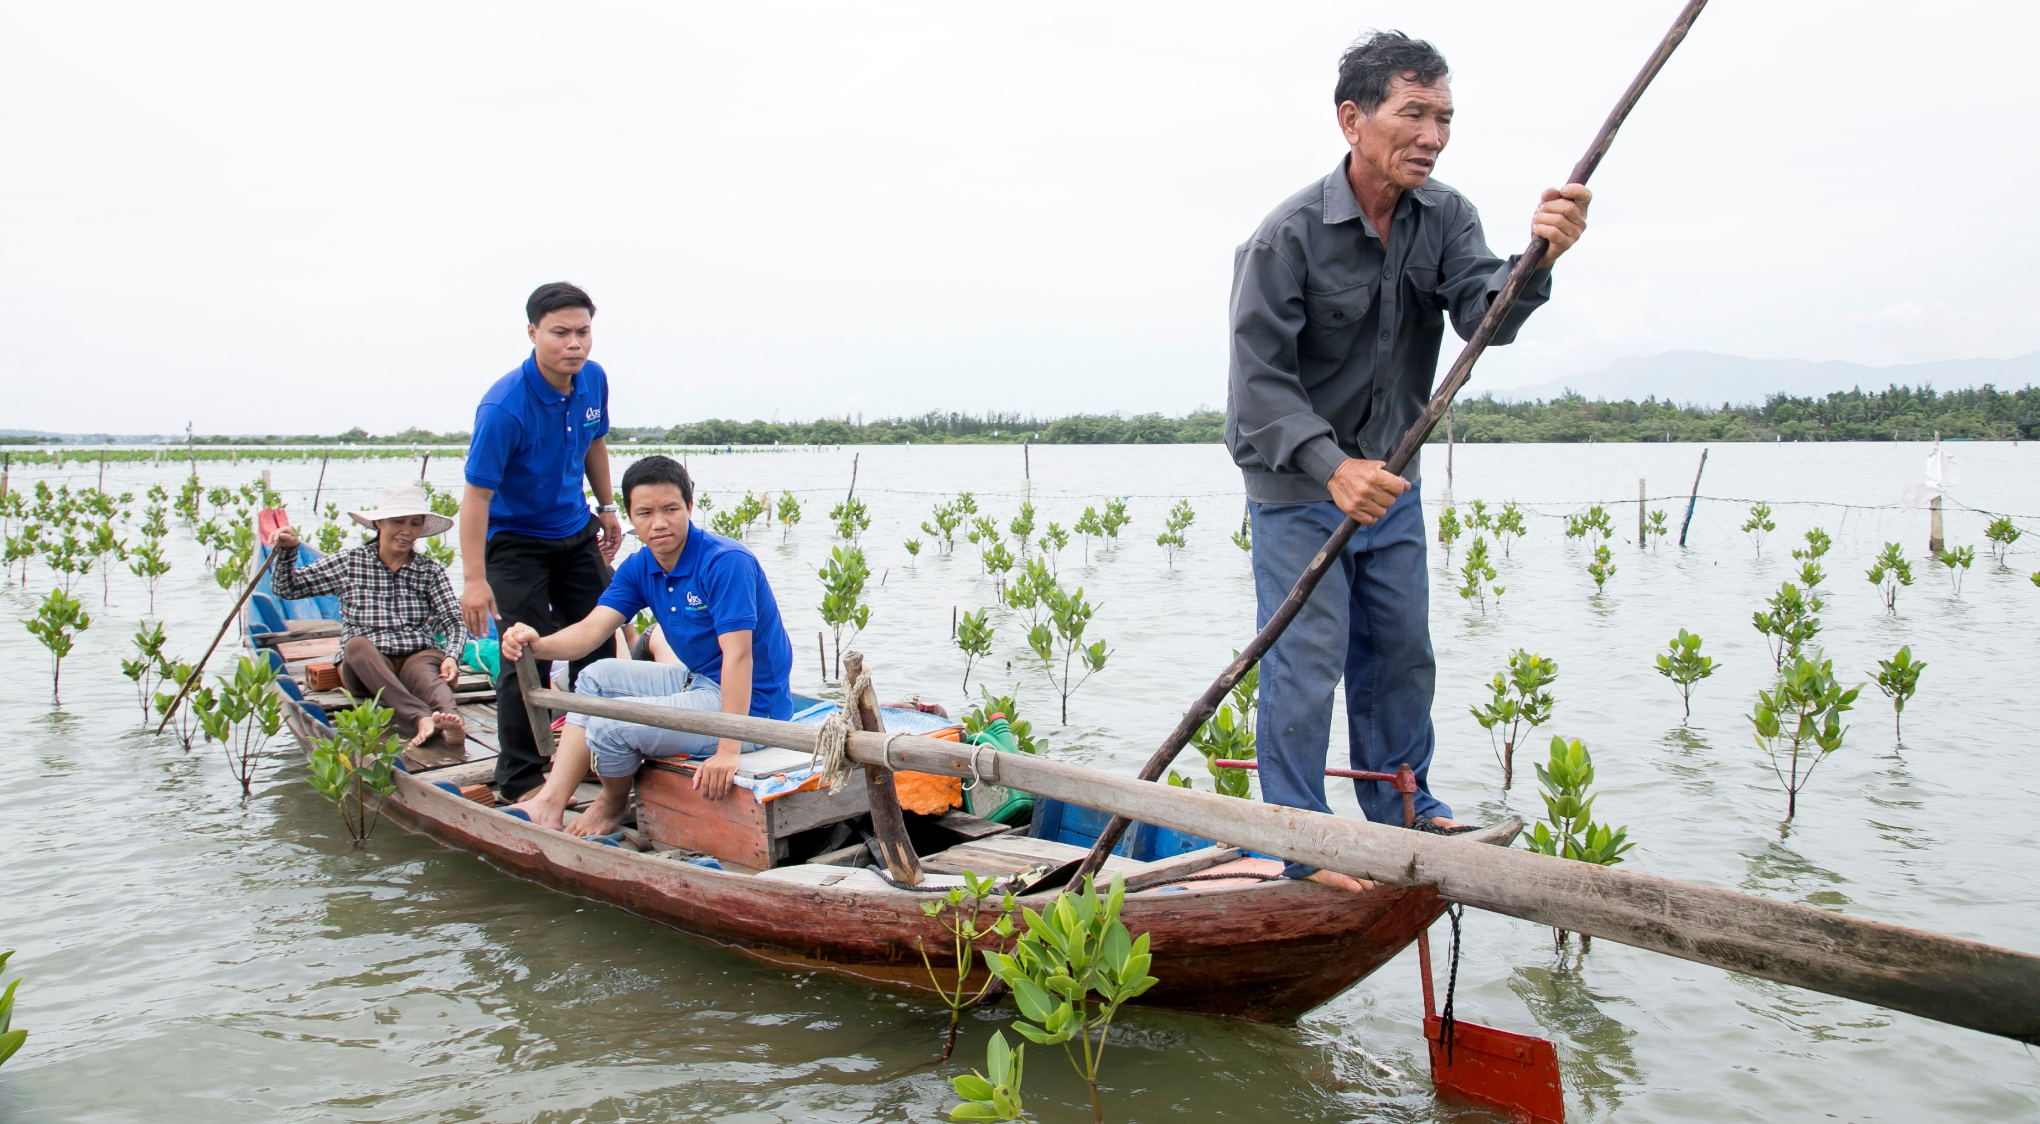
Environmental Stewardship Tool

Slide 2
Training Objectives
By the end of the session, participants will understand:
Why we promote Environmental Stewardship in development and humanitarian programming
What the tool intends to do
When to use the tool
Who should use the tool
How to use the tool
Practice using the tool using a scenario from development or humanitarian context

Slide 3
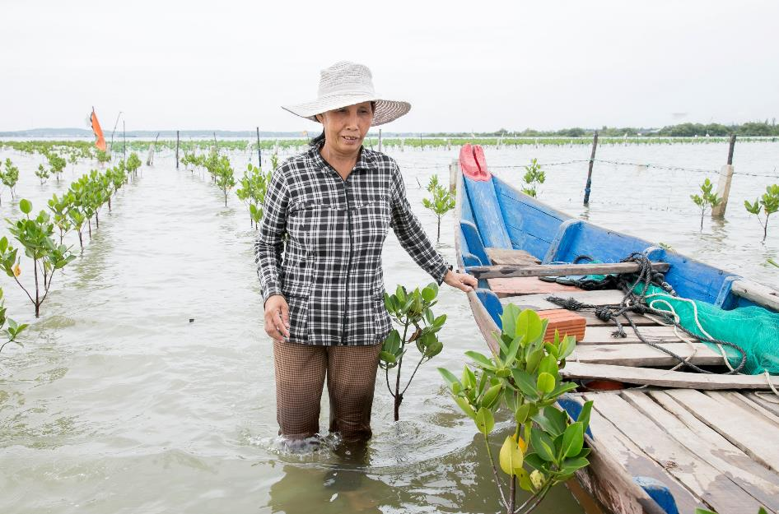
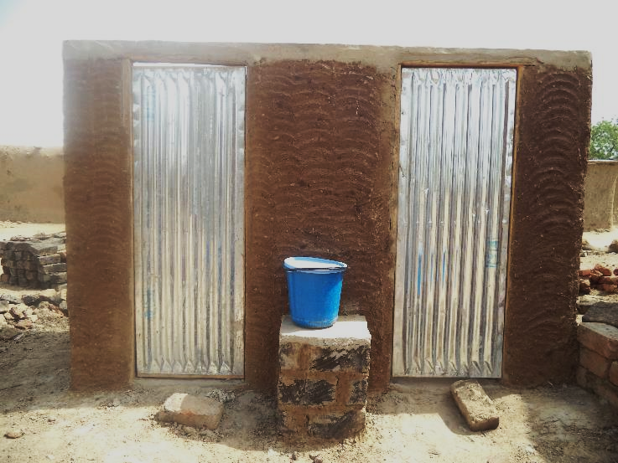
What is Environmental Stewardship?
The sustainable use and management of resources, active restoration activities and actions which result in the positive adaptation of vulnerable communities
Reestablishment of mangrove plantations in Central Viet Nam. Mangroves served to both restore fish populations and act as a natural barrier again storms and storm surge, protecting community assets
Use of local materials for construction of latrine facilities during humanitarian response in Cameroon reduces threat of deforestation

Slide 4
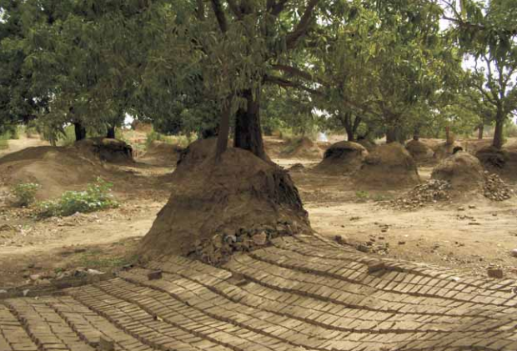
Why Environmental Stewardship?
As Practitioners:
Environmental issues can be underlying and contributing factors to short and long term crises
Addressing and adapting to a changing climate is imperative for everyone, most notably the vulnerable communities in which we work
Humanitarian and development interventions can also cause negative impacts on the environment and aggravate underlying environmental problems and exacerbate risk and vulnerability
As Catholic Agencies:
Stewardship is a component of Catholic Social Teaching
Adheres to Lau’dato Si (Pope Francis’ Second Encyclical) Responding to the ‘Cry of the Earth and the Cry of the Poor’
Business Case:
Compliance and accreditation with donors; linked with CHS
Brick production destroys mango grove – Nyala, Sudan (UNEP 2008)
Notes:
Destruction of livelihoods and deforestation as a result of brick production for humanitarian operations in Darfur. Dried up wells due to over-drilling for water by humanitarian organisations in Afghanistan. Ruined livelihoods from an over-provision of fishing boats and consequent fishing stock depletion in post-Tsunami Sri Lanka. Failure to meet waste treatment standards leading to environmental contamination in Haiti and the largest outbreak of cholera in recent history. These examples illustrate how humanitarian or peacekeeping actors, by failing to take environmental issues into consideration, undermine their purpose: to save lives and preserve and restore human livelihoods
Laudato Si’ proclaimed a bold challenge to the world. It gave long-overdue expression to a brewing sense of urgency in a powerful, inspiring way. It drew together various voices, Christian, non-Christian, scientific, poetic, which have all resounded in demanding action on climate change, biodiversity loss, waste and the other threats to the earth, our common home. These many voices seemed to point to a difficult and inconvenient truth. In Pope Francis’ words, we need a ‘redefinition of progress’ (Laudato Si’ #194); given that the current trajectory is failing people and the planet. The cry of the earth and the cry of the poor, if we listen to them, draw our attention to the same irresponsible practises, exploitation, and models of development which might look like progress on paper, but actually stand in the way of the flourishing of people and the environment they inhabit. This was a basic conviction of the Pope’s encyclical: “The same mindset which stands in the way of making radical decisions to reverse the trend of global warming also stands in the way of achieving the goal of eliminating poverty.” (Laudato Si’ #175).

Slide 5
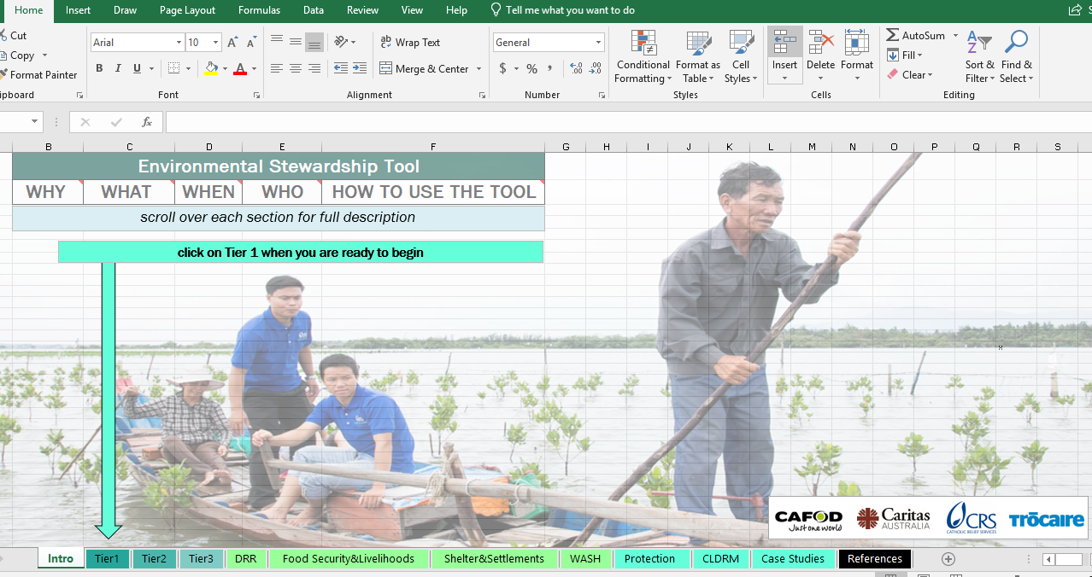
Environmental Stewardship Tool (EST) - background
Finalized in May 2019, the EST was developed as part of the DRR/Resilience Coordination Initiative at Caritas Australia, CAFOD, CRS and Trocaire
EST was developed by DRR/Resilience Coordination Group
3 rounds of review by over 30 CI agency focal points for DRR, Food/Livelihoods, Security, M&E, Protection, Shelter/Settlements, WASH along with project managers, heads of programmes, M&E staff
Piloted in 6 countries (Australia, DRC, Rwanda, Kenya, India, Indonesia)
Notes:
This tool was derived from an environmental risk register developed by the Shelter and Settlements and WASH teams from the Humanitarian Response Department (HRD) at CRS. In addition, there was a review of various industry tools, some of which were incorporated into the content of the EST

Slide 6
Environmental Stewardship Tool (EST) – What is it?
Excel tool which allows for rapid identification of environmental impacts of natural and manmade systems along with safeguarding issues within areas of programme activities
Identifies what these environmental impacts look like in the specific context
Registers the level of “risk” each of these impacts may have (low, medium and high)
Provides sectors specific guidance (DRR, Food Security/Livelihoods, Shelter/Settlements, WASH) as to how programme activities can mitigate the risk identified
The tool should be used to facilitate a conversation with the Project Design Team about potential negatives environmental impacts and strategies to address them

Slide 7
Limitations of the EST Tool.
It is not an EIA, but a precursor to the EIA process.
The EST won’t give you the right or wrong answers but will give you an indication of the issues to further explore on environment impacts of the proposed interventions.
It is only an internal organisational tool. Other national environmental regulations have to be complied with.
While the tool can flag potential policy and advocacy issues, it does not offer guidance on how to address these

Slide 8
EST – Who uses it and when?
Generally used during the programme design phase by the design team once a draft results framework or draft activities have already been identified.
Estimated time: Between 1 – 4 hours depending on context and size of programme
Programme Design Team: The programme design team may consist of but is not limited to agency/partner staff along with government representatives, community members, or anyone else involved in the design/implementation of the programme

Slide 9
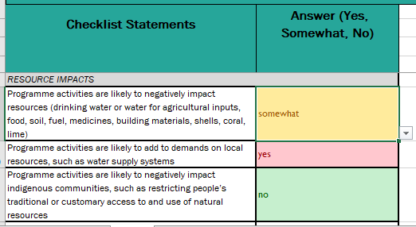
Getting familiar with the tool…
Take some time to get familiar with the tool, focus on looking only at:
Risk Identification (Tier 1)
Risk Profiling (Tier 2)
Risk Register and Mitigation (Tier 3)

Slide 10
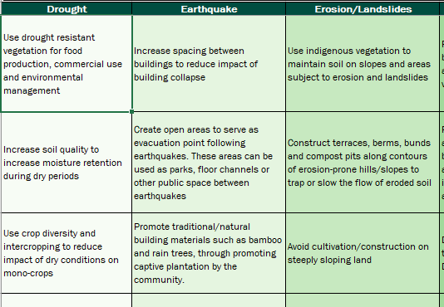
Sector Specific Guidance
EST provides guidance on incorporating environmental stewardship into specific sectors including:
DRR
Livelihoods/Food Security
Shelter and Settlements
WASH
Notes:
All guidance should be tailored to the local guidance. The guidance presented here is generalized. For the DRR tab, a majority of the guidance comes from the Green Recovery and Reconstruction Toolkit (GRRT) developed by American Red Cross and WWF and funded by USAID. Additional guidance was developed by technical advisors across the CI network. For the Livelihoods/Food Security Tab, most of the guidance was originally developed from Trocaire’s Sustainable Resource Use and Management Framework

Slide 11
Protection Mainstreaming and the EST
Protection Mainstreaming is the process of incorporating protection principles and promoting meaningful access, safety and dignity in all humanitarian aid and development activities.
The EST includes guidance on protection, specifically relating to:
Relevant questions to consider when categorizing risks under Tier 2
Relevant questions to consider when developing mitigation activities from Tier 3
Additional guidance providing from the Guide to Facilitating Community Led Disaster Risk Management (CLDRM) which aims to promote Inclusion, Leadership and Accountability

Slide 12
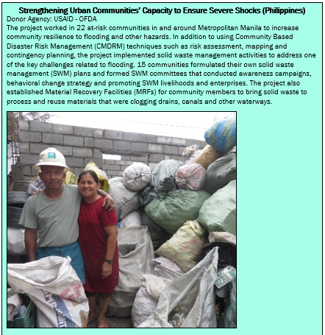
Case Studies
EST contains 10 short case studies showcasing environmental stewardship in past programming from across 7 different countries, including:
Afghanistan
Bolivia
Cameroon
Nepal
Philippines
Viet Nam
Zimbabwe

Slide 13
Applying the EST to a real world scenario…
In small groups, do the following:
Select one of the scenario hand outs, they are from:
Livelihoods Programme (development context – rural)
Shelter and WASH Programmne (humanitarian response context)
WASH and DRR Programme (humanitarian recovery context - urban)
Familiarize yourself with the scenario
Work on one computer using the EST to analyze the scenario
Present your findings and your experience using the tool to the overall group

Slide 14
Applying to other contexts, closing
What are the benefits/opportunities of using the EST in your work?
What specific challenges do you see in applying the EST in your work?
Other questions or clarifications regarding the EST?
What is next after such a process?

Slide 15
THANK YOU!!!

