Slide 1
Market Concepts
MBRRR Training
Session 1.4

Slide 2
Markets: Overview
Why are markets important?
Market definitions
Group Exercise: Market functioning and efficiency
Market integration
Market competition
Policy impacts
Seasonality

Slide 3
Why are markets important?
Markets are a part of everyone’s lives
Most people – especially the poor – rely on markets to provide food, essential goods and services
Markets also provide access to paid work and mechanisms for selling commodities and services
Strengthening markets can improve everyone’s lives and livelihoods
Harming markets can have serious negative impacts, particularly on the poor
Important to understand markets, so we know if our programs are strengthening or harming markets

Slide 4
Why consider markets in emergencies?
Markets can be affected by a shock.
Markets can form part of the response.
Markets can be affected by the response.
Notes:
Markets can be affected by a shock.
Poor and erratic rainfall reduces farm production and market supply, leading to higher food and grain prices for consumers.
As grain prices rise, livestock prices may decline due to illness, poor body condition, and the decline in terms of trade with respect to grain.
Storms and floods might destroy roads; spoil grain stocks and sever supply chains, preventing markets from being re-supplied.
Excessive fuel prices increase transport and processing costs, shrink trader margins and incentives, and, thereby, depress producer incomes, and increase consumer prices.
Markets can form part of the response.
Traders move supplies from surplus areas that are less affected by the crisis to supply deficit areas based on price signals.
Governments buy food from surplus areas or import food, and sell these stocks into the local market in an effort to increase the supply of food and stabilize rising prices.
Institutions (government and non-government) make local purchases from surplus areas and support food distribution in deficit areas, or supply vulnerable populations with vouchers or cash as part of humanitarian response and social welfare programs.
Markets can be affected by the response.
An influx of food aid can reduce acute price spikes caused by food shortages, improving food access even for non-beneficiaries.
An influx of food aid can depress prices, lowering farmer and trader incomes.
Cash, voucher programs can stimulate demand, driving up food prices.
Trade barriers may disrupt market flows, cause shortages and result in high food prices.
FEWS NET Markets Guidance No.6 “Markets, Food Security and Early Warning Reporting.” October 2009, p.5

Slide 5
Market Definitions
Markets –
Market chain –
Market system –
Notes:
A commodity is something tangible, that has value and can be exchanged.
Ask: what are market actors? – all the different individuals and enterprises involved in buying and selling in a market system.
Ask participants to name different market actors, and write on flip chart.
May include small-holder farmers, large-scale producers, assemblers, importers/exporters, traders, itinerant traders, processors, transporters, wholesalers, retailers and consumers.
Along a market chain, each trader buys and sells at different prices.
The difference between the buying and selling price – minus other costs (storage, transport) – is called the margin
When we consider the whole market system, who else might we consider in the list above?
Others behind the scenes: storage owners, input suppliers, credit suppliers, government officials and policies

Slide 6
Market Definitions
Markets – where buyers and sellers come together to obtain information and exchange commodities.
Market chain –
Market system –
Notes:
A commodity is something tangible, that has value and can be exchanged.
Ask: what are market actors? – all the different individuals and enterprises involved in buying and selling in a market system.
Ask participants to name different market actors, and write on flip chart.
May include small-holder farmers, large-scale producers, assemblers, importers/exporters, traders, itinerant traders, processors, transporters, wholesalers, retailers and consumers.
Along a market chain, each trader buys and sells at different prices.
The difference between the buying and selling price – minus other costs (storage, transport) – is called the margin
When we consider the whole market system, who else might we consider in the list above?
Others behind the scenes: storage owners, input suppliers, credit suppliers, government officials and policies

Slide 7
Market Definitions
Markets – where buyers and sellers come together to obtain information and exchange commodities.
Market chain – the sequence of market actors who buy, sell and transform a product or item as it moves from the initial producer to final consumer.
Market system –
Notes:
A commodity is something tangible, that has value and can be exchanged.
Ask: what are market actors? – all the different individuals and enterprises involved in buying and selling in a market system.
Ask participants to name different market actors, and write on flip chart.
May include small-holder farmers, large-scale producers, assemblers, importers/exporters, traders, itinerant traders, processors, transporters, wholesalers, retailers and consumers.
Along a market chain, each trader buys and sells at different prices.
The difference between the buying and selling price – minus other costs (storage, transport) – is called the margin
When we consider the whole market system, who else might we consider in the list above?
Others behind the scenes: storage owners, input suppliers, credit suppliers, government officials and policies

Slide 8
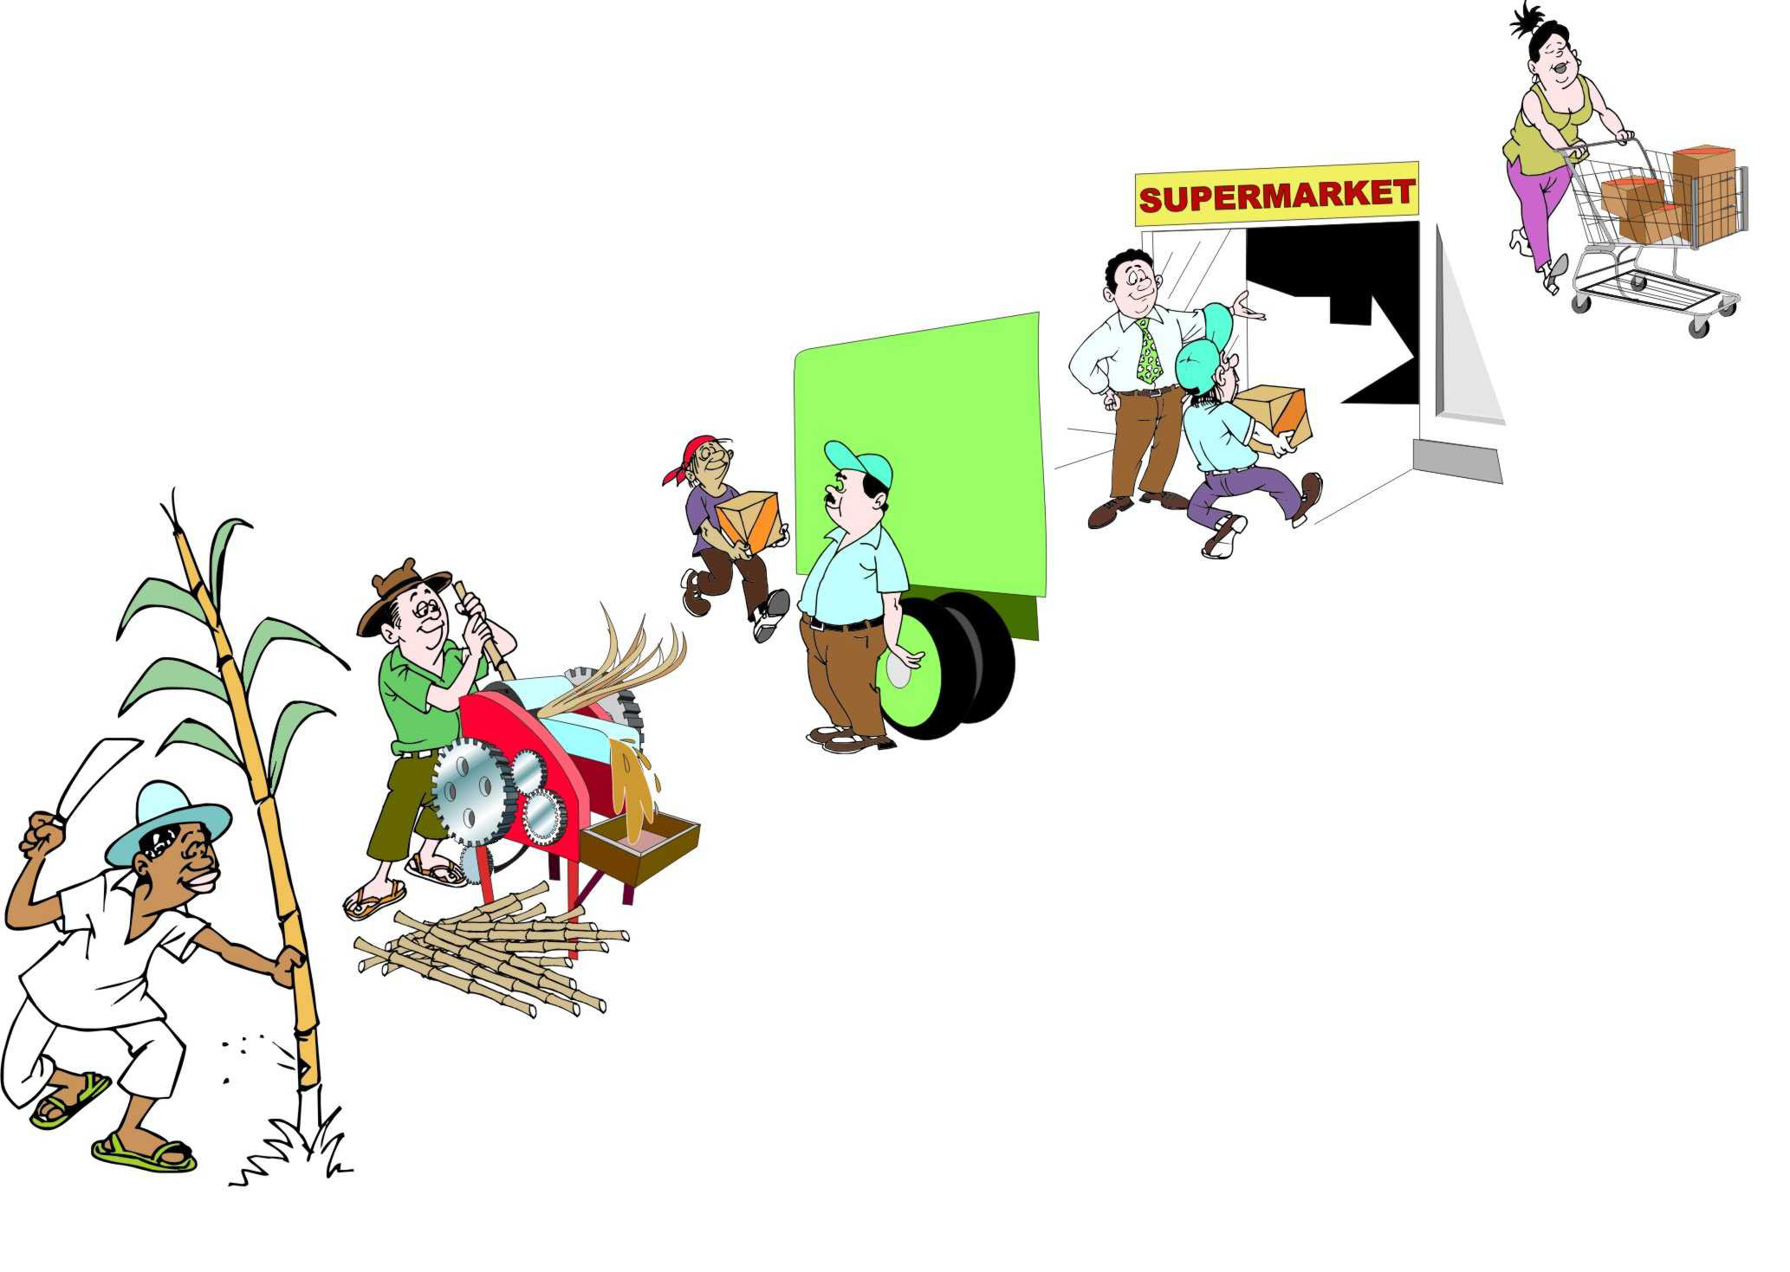
N.B. In supply market systems, this is a “supply chain”
In income market systems, this is a “value chain”

Slide 9
Market Definitions
Markets – where buyers and sellers come together to obtain information and exchange commodities.
Market chain – the sequence of market actors who buy, sell and transform a product or item as it moves from the initial producer to final consumer.
Market system – the complex web of people, trading structures and rules that determines how goods and services are produced, accessed and exchanged.
Notes:
A commodity is something tangible, that has value and can be exchanged.
Ask: what are market actors? – all the different individuals and enterprises involved in buying and selling in a market system.
Ask participants to name different market actors, and write on flip chart.
May include small-holder farmers, large-scale producers, assemblers, importers/exporters, traders, itinerant traders, processors, transporters, wholesalers, retailers and consumers.
Along a market chain, each trader buys and sells at different prices.
The difference between the buying and selling price – minus other costs (storage, transport) – is called the margin
When we consider the whole market system, who else might we consider in the list above?
Others behind the scenes: storage owners, input suppliers, credit suppliers, government officials and policies

Slide 10
Market Characteristics and Efficiency
A market is said to be functioning well when…
A market is said to be functioning inefficiently when…

Slide 11
Market Characteristics and Efficiency
A market is said to be functioning well when goods flow into the market in times of deficit and out in times of surplus, via private trading.
A market is said to be functioning inefficiently when the costs of moving commodities in and out of markets are greater than the marginal profit received to do so.

Slide 12
Market Characteristics and Efficiency
Relative functioning of a market depends on:
Integration across markets
Market structure (competition)
Availability of information on prices and costs
Formation of prices
Ease of entry and exit
Reliability of contract enforcement
Institutional framework (infrastructure, government policies, etc.)
Seasonality

Slide 13
Market Characteristics and Efficiency
Relative functioning of a market depends on:
Integration across markets
Market structure (competition)
Availability of information on prices and costs
Formation of prices
Ease of entry and exit
Reliability of contract enforcement
Institutional framework (infrastructure, government policies, etc.)
Seasonality

Slide 14
Market Integration
Market integration – The degree to which market systems in different geographical areas are connected to each other.
Markets are integrated when:
price shocks from one geographic market are transmitted to other markets through the trading of goods.
supply of food adjusts spatially to meet demands.
an increase in prices in a market signals traders to bring in more supply, bringing prices back down.
Notes:
If market integration is poor due to weak information and infrastructure and high transport and marketing costs, supply will not flow into the market, increasing prices for the population. In such cases, the local procurement of food can have significant effects on local prices.

Slide 15
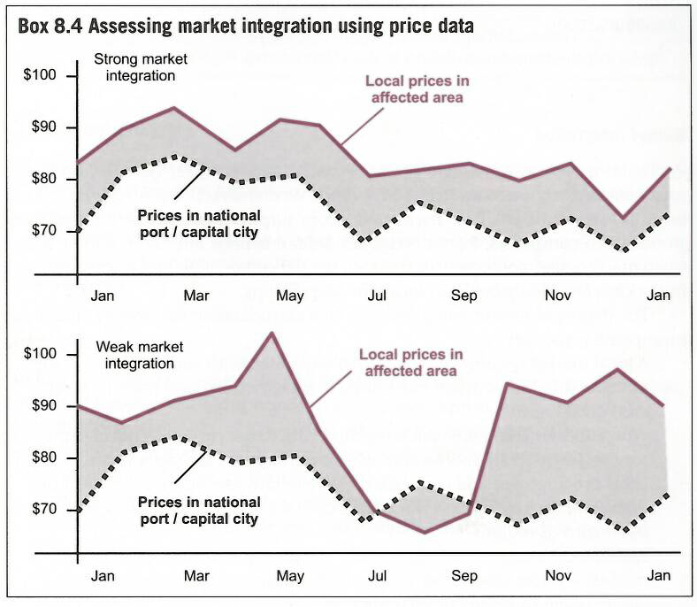
Market Integration
Notes:
How can you tell which markets are integrated?
Similar price trends, with the difference in prices due to marketing costs (transport)
Markets are not integrated because price peaks in the local market did not act as a signal for more supplies from the capital. During harvests, food is not moving out to bring prices back up.
Market integration smooths seasonal price fluctuations.
Criteria for good integration – good road infrastructure, geographical distances, market information, high number of market actors
Criteria for poor integration – high transport costs, insecurity, informal taxes during routes, poor road structure.
Changes in emergency – damage to transport infrastructure, elimination of key market actors who provided links with other markets, lack of finance for trading activities (break down of credit), insecurity and conflict
Why is it important? If market is not integrated, increasing demand through cash/vouchers will not signal more supplies, causing prices to increase.

Slide 16
Market Competition and Power
Competition – rivalry in the market place. Exists when buyers and sellers have a real choice between alternative market actors.
Market power – a single actor – or small cartel working in collusion – is able to dictate or strongly influence prices in their own favor, thus earning excessive profits.

Slide 17
Market Competition
Small-scale producers
N = 200
Traders
N = 2
Consumers
N = 4000
Small-scale producers
N = 200
Traders
N = 15
Consumers
N = 4000
Notes:
How might competition decrease in emergency?
Reduced competition – market actors exit
Increased monopolistic behavior – actors start colluding
Greater exclusion – worse restrictions on where and when certain market actors can operate
Greater market distortion – actions by governments (or aid agencies) which temporarily disadvantage vulnerable producers or depress economic activity.
Why is it important?
If there is not competition in markets, collusion between traders can cause prices to rise (or stay high), even though supplies are available and the market system is otherwise performing well
How might our program design affect market power?
Can facilitate the entry of new actors
Can target certain types of traders in our voucher and procurement programs (positive or negative impact)

Slide 18
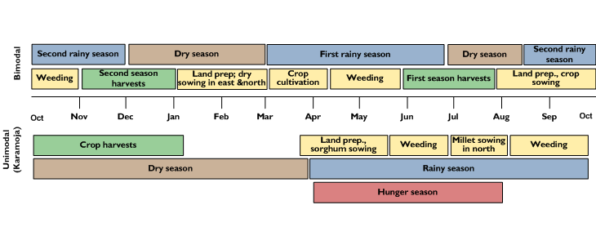
Seasonality

Slide 19
Seasonality
Notes:
The number and type of participants engaged in the market may change over the year.
For example, the numbers of traders and transport services tend to peak around the harvest period.
The volume, origin and quality of commodities in the market change over the year.
Local products are more common at harvest time and imported products are more common during the lean season.
Road infrastructure becomes unusable during the rainy season in areas that do not have all-weather roads.
The quality of perishable products such as vegetables and grains changes throughout the year and can influence prices.
Market prices at all levels of the market also follow seasonal patterns.
Why is it important – Changes in price and volumes may not be due to the emergency.
Need to know how to compare baseline and post-emergency data
Certain programs may work in certain times of the year, but not in others. Interventions needed may be different.

Slide 20
FEWs: Policy impacts (Lesson 3, p. 24)

Slide 21
FEWs: Policy impacts (Lesson 3, p. 24)
Notes:
Why is this important – changes in government policy may impact needs and the feasibility of certain interventions. Need to continue to monitor over the course of the project and adapt project as necessary.

Slide 22
Key Messages
Most people, especially the poor, rely on markets to provide food, essential goods and services; markets also provide access to paid work, and an outlet for selling commodities and services.
Strengthening markets can improve everyone’s lives and livelihoods; harming markets can have serious negative impacts, particularly on the poor.
It is important to understand markets, so we know if our programs are strengthening or harming them.

