Slide 1
SEEP Minimum Economic Recovery Standards (MERS): Overview
MBRRR Training
Session 1.3
Source: SEEP MERS training materials, 2014

Slide 2
Session Overview
What is economic recovery?
Why standards in economic recovery?
Overview of MERS:
Goal
Audience
Structure
Specific standards in more detail:
Core
Assessment & analysis
Technical standard: Productive Assets

Slide 3
Provides people affected by disaster:
an opportunity to earn income via employment or operation of a business;
contributes to dignity;
assists people to recover from the crisis;
a vocation and ability to practice that allows individuals to meet their own needs.
What is economic recovery?
Rapid, tailored support for livelihoods, enterprises and economies in the wake of a crisis.
7

Slide 4
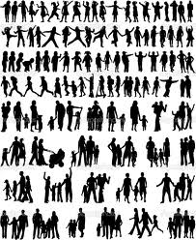
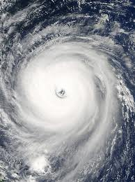
Why Standards in Economic Recovery?
Many dead and missing
Most crops and livestock destroyed
Roads and other infrastructure badly damaged
3

Slide 5
Why Standards in Economic Recovery?
What do you need most from the humanitarian organizations present in the next week?
What do you most need from agencies in the next three weeks?
What support do you most want from humanitarian providers in the next 1 – 6 months?
4

Slide 6
Why Standards in Economic Recovery?
Financial services
Productive assets
Employment
Enterprise development
MINIMUM STANDARDS:
the least that beneficiaries should expect, and that humanitarian agencies should provide.
5

Slide 7
Overview of MERS:
The Goal of the Standards
To improve the impact of economic recovery programming by building consensus on good practices.
The Goal
Strategies and interventions that improve enterprises, employment, and cash flow and asset management among crisis-affected businesses and households.
9

Slide 8
Overview of MERS:
Audience for the Standards
Practitioners experienced in humanitarian situations, but less familiar with economic recovery initiatives;
Practitioners experienced in economic development, but unaccustomed to crisis environments;
Practitioners and programs working in multiple sectors in crisis environments (e.g. health, education, infrastructure, or HIV and AIDS).
10

Slide 9
Overview of MERS:
Structure of the Standards
Minimum Economic Recovery Standards
Core Standards for Economic Recovery
Assessment and Analysis Standards
Financial Services
Productive Assets
Employment
Enterprise Development
12

Slide 10
The MERS River
Minimum Economic Recovery Standards
FOUNDATIONAL
Core Standards for Economic Recovery
Assessment and Analysis Standards
Financial Services
TECHNICAL
Enterprise Development
Productive Assets
Employment
13

Slide 11
Qualitative in nature and specify the minimum levels to be attained.
Structure of the handbook
Standards
e.g: Core standard 1: Market-Oriented programming (page 20 Handbook)
“Program design and implementation decisions consider economic and market dynamics.”

Slide 12
Necessary activities and inputs in order to meet the minimum standards.
Structure of the handbook
Key Actions
e.g: Key action 1: Market-Oriented programming (page 20 Handbook)
“Conduct/identify market analyses to develop projects and interventions.”

Slide 13
“Signals” whether a minimum standard has been attained;
Way of measuring and communicating processes and results of key actions.
Structure of the handbook
Key Indicators
e.g: Key Indicator 1: Market-Oriented programming (page 21 Handbook)
“Interventions invest only in activities that target viable markets.”

Slide 14
Specific points to consider in different situations;
Guidance on tackling practical difficulties, benchmarks or advice on priority issues;
Critical issues or gaps relating to the standards.
Structure of the handbook
Guidance Notes
e.g: GN 1: Market-Oriented programming (page 21 Handbook)
“Viable markets: Understanding the markets….”

Slide 15
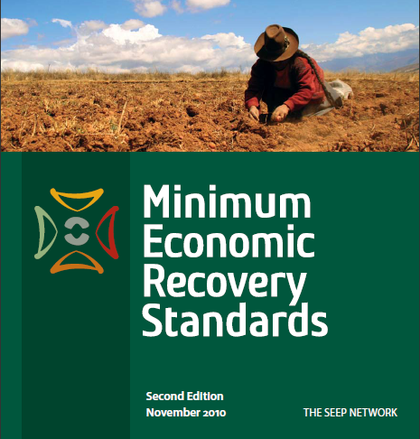
http://www.seepnetwork.org/minimum-economic-recovery-standards-resources-174.php
Specifics
Core; Assessment & Analysis Productive Assets
Notes:
Find the standards online, or go to your book if you have one.

Slide 16
Core Standards Quiz
Preparation for quiz:
Only skim-read whole of section on Core Standards; it will be open-book quiz.
Find out which standard(s) your two questions refer to.
What are the answers to your two questions? Be ready to use these in the quiz.
Rules of quiz:
You know the answer? Put up up your hand.
Right answer: gain a point for the group. Wrong answer: lose a point.
Shouting out answer: lose a point for the group.
Winner is group with most points at the end.

Slide 17
Core Standards
Standard 3
Staff Competencies
Standard 1
Market-Oriented Programming
Standard 2
Coordination and Effectiveness
Standard 4
Do No Harm
Standard 5
Well-Defined Targeting and Intervention Strategy
20

Slide 18
The Core Standards: Summary
Entry point for all other technical standards;
Ensure quality and accountability, processes and procedures required for good practice;
Aim at avoiding undermining the economic well being of affected people by:
ensuring food supply;
maintaining ability to spend on essentials;
retaining productive assets;
retaining maintenance and investments;
avoiding unnecessary sale of equipment;
keeping key workers.
Notes:
Core Standard 1: Market-Oriented Programming Program design and implementation decisions consider economic and market dynamics.
Core Standard 2: Coordination and Effectiveness Economic recovery is planned and implemented in coordination with the relevant authorities, humanitarian agencies, and civil society organizations, working together for maximum efficiency, coverage, and effectiveness—in partnership with the private sector for greater lever-age and impact.
Core Standard 3: Staff Competencies Programs are staffed by individuals well versed in economic recovery principles and/or who have access to technical assistance. Programs in-clude capacity building components to improve the skills of field staff
Core Standard 4: Do No Harm The operations, products, and waste of economic recovery interventions address or minimize potential harm and do not exacerbate economic disparity analysts
Core Standard 5: Well-Defined Targeting and Intervention Strategy Selection of the best intervention point is based on sound client and market analysis, and an understanding of the desired economic out-comes. These outcomes may be achieved through a variety of intervention points and partnerships, not only through direct intervention.

Slide 19
The Assessment & Analysis Standards: Summary
Assessment and Analysis Standards
Standard 1
Scope
Standard 2 Timing
Standard 3 Data and Methods
Standard 4 Analysis
Standard 5 Dissemination & Formats
22
Notes:
AAS1: Scope Coordinated assessments synthesize critical information, including information about affected households’ livelihoods, market systems, socio-political and conflict dynamics, and considerations, such as gender, youth, and the environment.
AAS2: Timing Assessments are both pre-conditions to designing program interventions and critical tools to regularly inform decision-making for program management and implementation.
AAS3: Data and Methods Assessment data is gathered using objective, inclusive, and ethical methods that ensure data quality, utility, and participants’ security.
AAS4: Analysis Analysis of data and information is timely, transparent, and objective. Analysis informs programming decisions and other actions that facilitate economic recovery.
AAS5: Dissemination and Formats Assessment results are disseminated to provide appropriate guidance to decisionmakers.

Slide 20
Assessment & Analysis Standards: Summary
Center on market systems, household economies, broader economic constraints and opportunities;
Continuous and ongoing analysis of market dynamics;
Address importance of ongoing program monitoring, evaluation and dissemination of results.
23

Slide 21
Technical Standards
Minimum Economic Recovery Standards
Core Standards for Economic Recovery
Assessment and Analysis Standards
Financial Services
Productive Assets
Employment
Enterprise Development
12

Slide 22
Productive Assets Standards
The Standard for All Asset Programming should ensure:
the proposed bakery is appropriate for Romana;
the group develops the capacity to manage the bakery, for example in relation to the operation of the ovens and their maintenance and repair.
The Standard for Assets for Livelihoods Expansion and Development should ensure:
the group gets the support it needs to market its products.
The Standard for Assets Protection should ensure:
the women are less vulnerable to future crises.
35

Slide 23
Productive Assets Standards
Relevant foundational Standards
From the Core Standards:
the Market Orientated Programming Standard should ensure there is a viable market for the bakery's products.
From the Assessment and Analysis Standards:
the Analysis Standard should ensure that appropriate monitoring and evaluation is put in place.
36

Slide 24
Productive Assets Standards:
General Summary
Productive assets: those used to generate income and profit (as opposed to household items);
Covers items beneficiaries own or directly control, or they have access to but don’t belong to them;
Interventions used to protect, replace and increase the productive assets lost by households and enterprises during crises;
cont/…
37

Slide 25
Productive Assets Standards:
General Summary (continued)
Ensure using approaches complementary to other economic recovery strategies used in medium and longer term;
Replace lost assets, protect existing assets from being consumed, sold or lost;
Facilitate growth of asset base to increase incomes.
38

