Slide 1
Overview of MBRRR (Market-Based Rapid Response and Recovery)
MBRRR Training
Session 1.1

Slide 2
Session overview
Why is market-based programming important?
What is MBRRR?
Overview of minimum standards for MBRRR
Overview of available tools for assessment and analysis

Slide 3
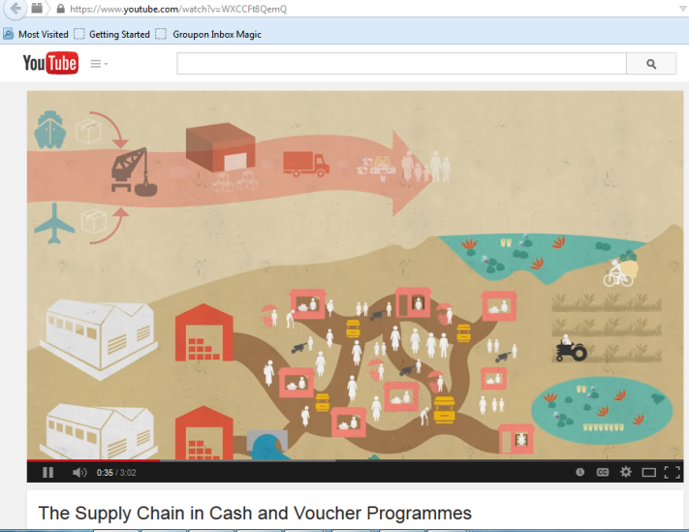
Why is market-based programming important?
https://www.youtube.com/watch?v=WXCCFt8QemQ

Slide 4
Market-based RRR
Broad set of disaster response options that move away from traditional bulk purchase and distribution methods to approaches that work through local markets and aim to give greater flexibility and choice to program participants.
Market-integrated relief
Market support
Market strengthening and development

Slide 5
Terminology
Market-integrated relief: practice of working through markets to provide relief and basic services (transfer of assets & services)
Indirect market support : address bottlenecks in market systems to facilitate the delivery of (a) specific good(s) to a defined vulnerable target group. Market support could include activities such as infrastructure rehabilitation, loans or grants to traders, transport subsidies, advocacy on trade policies etc.
Market strengthening and development: related to economic recovery and/or strengthening of market systems, primarily with the objective of reinforcing markets, and thereby protecting, rehabilitating and strengthening livelihoods.
Notes:
We don’t do the 3rd very much in emergency settings.

Slide 6
Terminology
Notes:
This is from the Oxfam Learning Event in London, 2011. CRS MBRRR focuses on market-integrated relief, mostly. CRS MBRRR also works on indirect support.
PIQA usually focuses on market strengthening and development, as this is a longer-term goal, generall.
The purpose of this slide is to reiterate the last 3, visually.

Slide 7
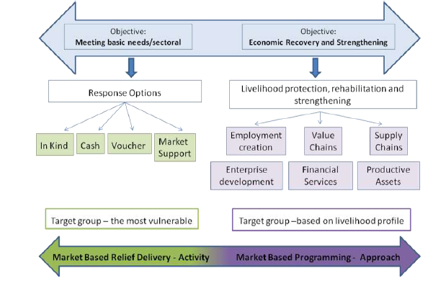
Response Analysis
Notes:
Response Analysis is: The analytical process by which the objectives and modality of program response options are determined, and potentially harmful consequences are minimized
2 common types of market-based programs include:
Cash
Vouchers
Indirect market support is less common, but also critical.
Q: Why is “in-kind” considered market-based here?
A: The decision to do an in-kind distribution should still be based on some kind of assessment of needs as well as market function. Thus, even an in-kind distribution should not be “market indifferent”.

Slide 8
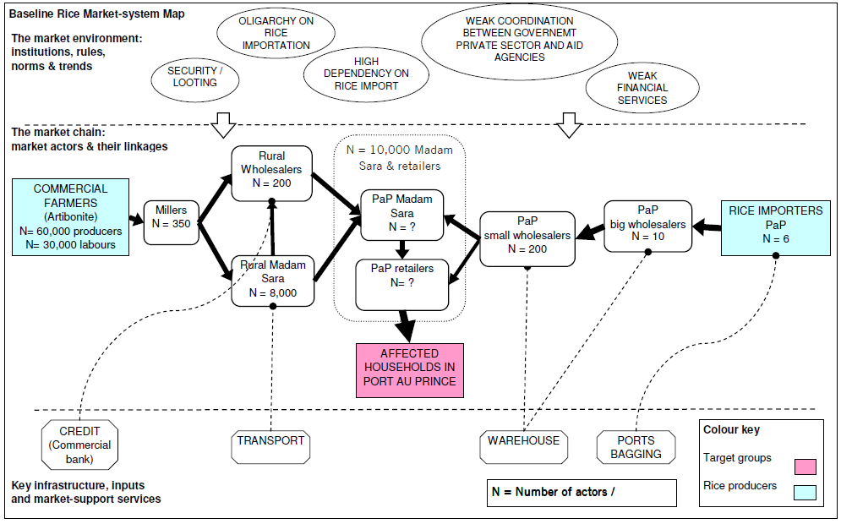
Response Analysis: Pre-crisis mapping
Notes:
If markets are functioning and other non-market factors are appropriate, consider a markets-based transfer.
This is an example of an EMMA map. We’ll draft these in a later session.

Slide 9
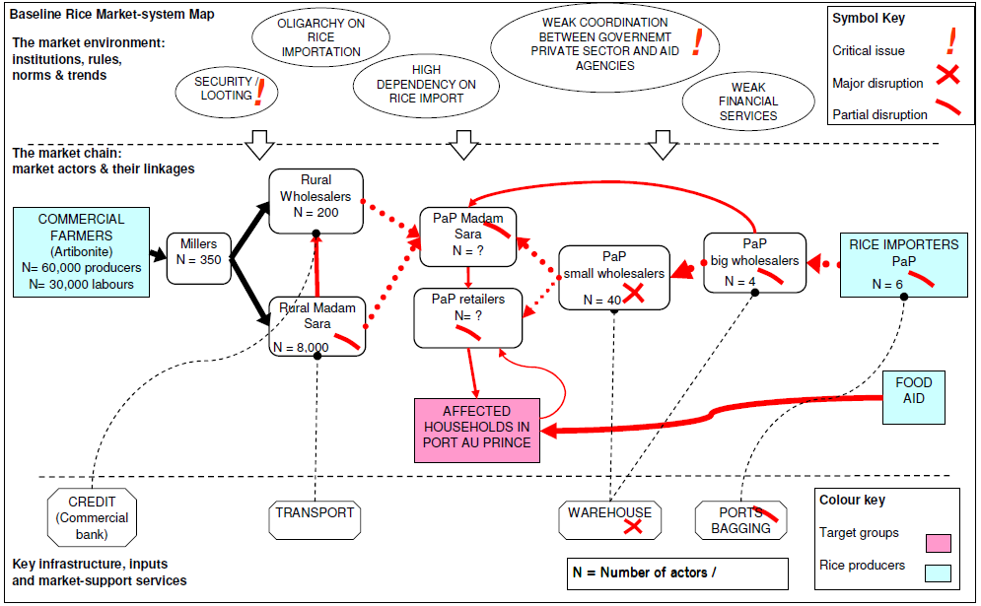
Response Analysis: In-kind
Notes:
This is an example of an EMMA map. We’ll draft these in a later session.
Q: What does this indicate?
A: That food aid is both an important part of our response – and can also affect other responses.

Slide 10
Response Analysis: Indirect Market Support
Notes:
This is an example of an EMMA map. We’ll draft these in a later session.
Q: What does this kind of map help show?
A: It shows possible response options. i.e. Here, there are additional forms of indirect market support that can be highlighted, like support to the warehouses, or the intermediary traders.

Slide 11
MBRRR SO (SIP)
SO 1 – CRS and partners’ Market-Based Rapid Response and Recovery programs meet Sphere core standards and SEEP core and assessment & analysis standards (MERS)
Notes:
MBRRR - Refers to a broad set of disaster response options that move away from traditional bulk purchase and distribution methods to approaches that work through local markets and aim to give greater flexibility and choice to program participants.
SEEP core standards are the “Minimum Economic Recovery Standards” (MERS)

Slide 12
SO1 Indicators
% of Final Evaluations (and/or Real Time Evaluations & After Action Reviews as appropriate) that report a high level [to be defined] of community (male and female) satisfaction related to the timeliness, appropriateness, effectiveness of the response
% of ERR projects that are based on gender-disaggregated emergency situational assessment and community consultation in the design
% of ERR projects that are based on a market assessment and response analysis
Value of cash or vouchers used by beneficiaries in local markets
Notes:
These are draft indicators, as of January 2015.

Slide 13
SO1 Indicators
Notes:
Please use these account codes!

Slide 14
SO1 Indicators
Notes:
Please use these account codes!

Slide 15
Sphere Core Standards
Notes:
Sphere Core Standards:
CS1: People-centered humanitarian response People’s capacity and strategies to survive with dignity are integral to the design and approach of humanitarian response.
CS2: Coordination and collaboration Humanitarian response is planned and implemented in coordination with the relevant authorities, humanitarian agencies and civil society organisations engaged in impartial humanitarian action, working together for maximum efficiency, coverage and effectiveness.
CS3: Assessment The priority needs of the disaster-affected population are identified through a systematic assessment of the context, risks to life with dignity and the capacity of the affected people and relevant authorities to respond.
CS4: Design and response The humanitarian response meets the assessed needs of the disaster-affected population in relation to context, the risks faced and the capacity of the affected people and state to cope and recover.
CS5: Performance, transparency and learning The performance of humanitarian agencies is continually examined and communicated to stakeholders; projects are adapted in response to performance.
CS6: Aid worker performance Humanitarian agencies provide appropriate management, supervisory and psychosocial support, enabling aid workers to have the knowledge, skills, behaviour and attitudes to plan and implement an effective humanitarian response with humanity and respect.

Slide 16
SEEP Minimum Economic Recovery Standards (MERS)
Focus on the minimum level of technical and other assistance to be provided in promoting the recovery of economies and livelihoods affected by crisis
Focus on strategies and interventions designed to improve income, cash flow, asset management, and growth among crisis-affected households and enterprises.
http://www.seepnetwork.org/minimum-economic-recovery-standards-resources-174.php
Notes:
Core Standard 1: Market-Oriented Programming Program design and implementation decisions consider economic and market dynamics.
Core Standard 2: Coordination and Effectiveness Economic recovery is planned and implemented in coordination with the relevant authorities, humanitarian agencies, and civil society organizations, working together for maximum efficiency, coverage, and effectiveness—in partnership with the private sector for greater lever-age and impact.
Core Standard 3: Staff Competencies Programs are staffed by individuals well versed in economic recovery principles and/or who have access to technical assistance. Programs in-clude capacity building components to improve the skills of field staff
Core Standard 4: Do No Harm The operations, products, and waste of economic recovery interventions address or minimize potential harm and do not exacerbate economic disparity analysts
Core Standard 5: Well-Defined Targeting and Intervention Strategy Selection of the best intervention point is based on sound client and market analysis, and an understanding of the desired economic out-comes. These outcomes may be achieved through a variety of intervention points and partnerships, not only through direct intervention.

Slide 17
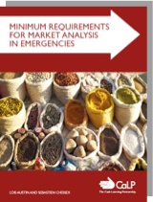
Other MBRRR tools
CaLP market assessment and analysis standards
CRS market assessment tool (market surveys, household-level surveys)
CRS decision tree tool (rf. MIFIRA, IRC)
EMMA market system maps
CRS cash/ voucher implementation tools (includes DiNERS manual)
MARKit
Notes:
Why is it important to assess markets? Need to understand the capacity of the market to meet needs locally, and the implications of different interventions on local markets.
N.B. CaLP standards are useful for designing market assessments. These standards include:
Goal: Market assessments inform response analysis to determine appropriate interventions.
Scope of assessment
MR1 The scope and depth of the market assessment enable appropriate programme decisions and are based
on identified information needs.
Analysis
MR2 Market analysis data informs key programme-related decisions and contributes to the selection of
appropriate modalities to achieve programme objectives whilst doing no harm.
Data collection
MR3 Collection of data is undertaken by competent and knowledgeable teams.
MR4 Data collection systems, procedures and information sources utilised in the market assessment are
appropriate and of sufficient quality to allow for the capturing of the dynamic nature of markets.
Monitoring and ensuring data validity
MR5 Monitoring activities provide a check against initial assessment findings and enable decision-making for
potential adaptation of interventions.

Slide 18
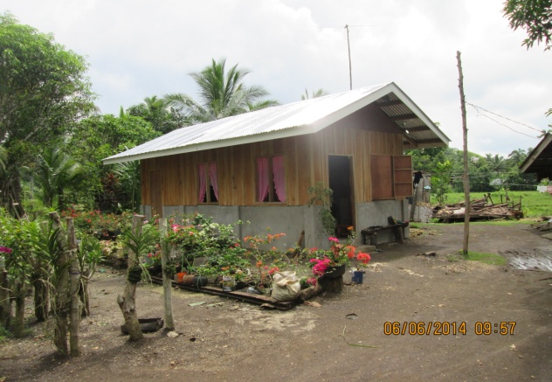
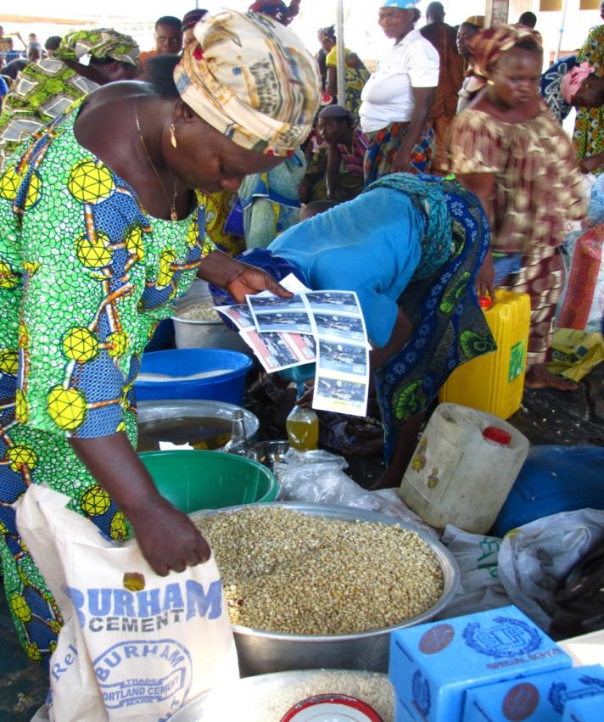
MBRRR Interventions
Food vouchers
Cash for shelter construction
Agricultural Input Fairs
Cash transfers
Market support

Slide 19
Key Messages
MBRRR aims to give greater flexibility and choice to program participants
MBRRR uses Sphere and MERS standards
MERS and CaLP are resources for market assessments
CRS has a suite of ‘standard’ tools
CRS has good experience to date

