Slide 1
Operations in Emergencies: Staff Care – CRS Policies & Procedures
Notes:
Welcome to the second presentation on staff care during emergencies.

Slide 2
Learning Objectives
Part A:
Understanding the effects humanitarian work may have on you & your colleagues
Managing stress on a personal level
Part B:
Adapting CP policies & procedures to support staff health & wellbeing
Notes:
In the first staff care presentation, the discussion focused on the effects humanitarian work may have on staff and the personal steps you and your emergency co-workers can take to mitigate these effects. If you haven’t seen this presentation, it would be good to watch it before viewing this one.
In this presentation, we will focus on how Country Programs may adapt policies & procedures at the organizational level, to support staff health and wellbeing during an emergency response and recovery.

Slide 3
What can CRS do
to support staff wellbeing in an emergency?
Notes:
In the first staff care presentation, we talked about the risks associated with high stress levels and the steps people can take to manage their personal stress… the emergency itself, however, can create barriers to staff taking these steps.
So – what can CRS do to support staff wellbeing in an emergency? To keep staff healthy and positive in the face of sometimes overwhelming circumstances?

Slide 4
Work & Wellbeing
Inform staff about the risks to their health & wellbeing
Minimize organizational stressors
Provide staff access to opportunities & resources that can help them promote their health & resilience
Notes:
Each individual is ultimately responsible for their own wellbeing.
CRS’ role is to facilitate each staff member’s ability to take care of themselves and to minimize any added burdens that may be created by the organization itself.
Country Program management should therefore concentrate on three key actions:
Informing staff about the risks to their health & wellbeing, and what they can do on a personal level to reduce these risks;
Minimizing organizational stressors on staff, and
Providing staff with access to opportunities & resources that can help them promote their health & resilience

Slide 5
Informing Staff
Provide staff with an orientation on:
safety, security & health risks (including stress)
protective CRS safety & security protocols
personal measures they can take to increase health & wellbeing
Physical
Emotional
Mental
Spiritual
Notes:
The first step is to ensure that staff are basing decisions on good knowledge. CRS should provide all staff with an orientation on the safety, security & health risks they will be facing during the emergency response, including the effects of stress. This orientation should be tailored to the context.
The orientation should also discuss the protective safety & security protocols CRS is putting in place, along with measures staff can take to promote their health, including the physical, mental, emotional and spiritual actions they can take to increase their resilience to stress.
Remember to provide this orientation to all staff, including country program staff – both international & national - as well as the new hires, volunteers, consultants, TDYers and those on short term assignments.

Slide 6
(source: Headington Institute)
Work & Stress
Common stress factors related to work include:
conflict among team members or with supervisors
unclear roles & responsibilities
lack of appropriate resources to do the job (e.g., personnel, time, logistical support, skills, etc)
heavy workloads & long hours
issues with leadership & management structure
unclear mission objectives
Preliminary research suggests
humanitarian workers often identify
organizational factors
as a major cause
of chronic stress
Notes:
The next thing Region and Country Program management can do is minimize organizational stressors. Common stress factors related to work are:
conflict among team members or with supervisors;
unclear job roles & responsibilities;
lack of appropriate resources to do the job expected… this can include things such as personnel, time, logistical support, or skills;
heavy workloads & long hours;
issues with leadership & management structure; and
unclear mission objectives
These types of issues can have a significant impact on your staff. In fact, humanitarian workers often identify organizational factors as a major cause of chronic stress.

Slide 7
Minimizing Organizational Stressors
Prioritize strong, experienced leadership who will:
clearly define staff roles & responsibilities
train & mentor new staff
provide on-going supervision & support
Keep all staff up to date on who’s responsible for what & how to get things done
Mental:
Develop job competencies,
Positive attitude
Notes:
One of the specific steps the region and country program can take to minimize organizational stressors is to focus on finding and retaining strong, experienced leaders for the emergency response & recovery… This senior leadership will be able to clearly define staff roles & responsibilities, train and mentor their staff, and provide ongoing supervision and support.
In addition, the country program management needs to ensure that staff are kept up to date on changes in the staff structure and procedures. This will help to create competent and cohesive teams, which in turn will lessen staff frustration, boost staff confidence in their ability to do their jobs, and foster positive attitudes.

Slide 8
Minimizing Organizational Stressors
Show appreciation for staff’s dedication, hard work & personal sacrifices
Consider:
Instituting Hardship & Hazard Pay
Recognizing & compensating staff in “acting” positions
Holding celebrations for achievements
Notes:
As part of this, it’s important to let staff know that their dedication, hard work and personal sacrifice are appreciated. Depending on the context, you should consider instituting or adjusting hardship & hazard pay, recognizing and compensating staff who are taking on additional responsibilities or “acting” capacities, and holding events to celebrate staff achievements and project milestones.

Slide 9
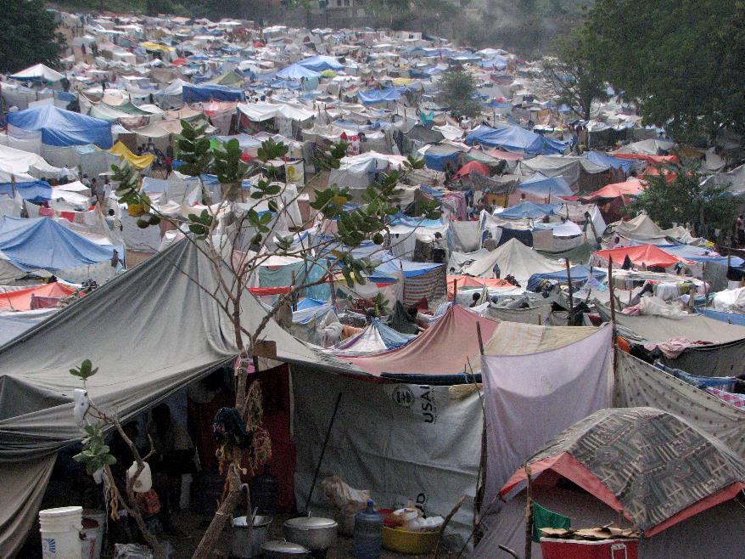
Minimizing Organizational Stressors
Promote understanding & collaboration between staff
Notes:
And it’s also important to remember that an emergency may hit one area or part of the country much more than another. When this happens, it can create tensions between those staff who are on the front lines, experiencing the devastation first hand, and those who are not. Those in the field will often feel a sense of urgency that the staff in the main office don’t… while the staff in the main office may feel that front line staff have unrealistic expectations of them and resent the pressure.
You’ll need to promote a sense of understanding and collaboration between staff… giving office-based support staff the opportunity to see the situation in the field and experience the challenges their colleagues are dealing with is often helpful in fostering this understanding.

Slide 10
Promoting Resilience
Let staff know how their effort is contributing to the response!
Spiritual:
Find meaning & purpose, Practice gratitude
Notes:
Letting people know how their efforts are contributing to the response, how they personally are helping to make life better for people affected by the emergency, is also important in helping staff retain a sense of purpose and meaning. This can be done through sharing progress updates and beneficiary stories with staff, and helping staff understand how their position or department is assisting in moving the emergency response forward.

Slide 11
Promoting Resilience
Ensure all staff have access to essentials, to meet their physical needs
Based on the context, consider:
reviewing & updating Per Diem rates
temporarily providing additional allowances during the emergency period
directly providing essentials (food, water, transport, accommodations, etc.) to staff, if these are not readily accessible
providing meals for staff who cannot leave their post
Physical:
Exercise, Sleep, Hydration, Healthy Diet
Notes:
In addition to the mental and spiritual support CRS can give to staff, also consider their physical and emotional needs.
On the physical side, staff must have access to basic necessities to sustain themselves, before they can do their job… this includes things like nutritious food, water, hygiene supplies, and a place to sleep. They will also need to be able to physically get to work.
In development programs, staff are typically expected to do this for themselves, using their salaries or – when going to the field – through per diem and hotel reimbursements. In an emergency, however, markets and infrastructure may have been negatively impacted. Availability and costs of basic necessities may have changed drastically. In some cases, national staff and local volunteers may also be dealing with the loss of their homes and belongings.
You’ll need to assess the effects the emergency may be having on your context and support your staff – both national and international - accordingly. Consider:
reviewing & updating Per Diem rates for the various locations staff will be working in, and
temporarily providing additional allowances during the emergency period, especially for national staff.
If markets are not functioning well, and essentials are not readily accessible to staff, CRS may need to directly provide these.
Note that providing meals for staff members may also be warranted if staff are working long hours or are out in the field, and cannot leave their post to find food.

Slide 12
Promoting Resilience
Ensure staff have adequate time away from work to recharge
Notes:
You’ll also want to ensure that staff have adequate time away from work to recharge. This includes having time to oneself, time to engage in exercise and other non-work related activities, and time to socialize with family and friends. Bear in mind that staff exercise and social activities should be low profile and culturally acceptable.
You might consider building some of this into work schedules – having group exercise or meditation time on certain days, or having an office lunch. For staff living in the field, movie nights or game nights are often popular.

Slide 13
Promoting Resilience
Physical:
Exercise, Sleep, Hydration, Healthy Diet
Review the hours staff are working & consider:
Updating schedules
Providing R&R or compensation time
Reviewing staffing structure & adding staff as necessary
Emotional:
Personal space, Social support
Notes:
You’ll also need to keep an eye on the amount of work time your staff are putting in. This will often be much higher than normal during an emergency response… Staff will not be able to sustain this for prolonged periods, so you’ll need to determine how to address this. This may be done through adjusting schedules – for instance, having rotating distribution teams which work three days and then have a day off. You may also consider putting R&R or compensation time policies in place. You should also be reviewing the staffing structure regularly & adding staff as necessary.

Slide 14
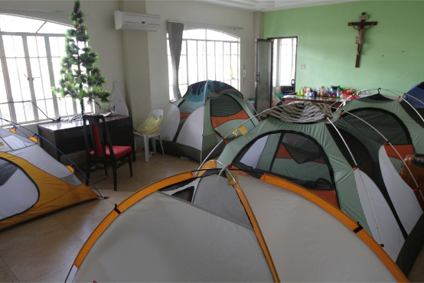
Promoting Resilience
For living accommodations, consider:
separating living & office areas
having both personal & social space for staff
including kitchen, entertainment & exercise equipment
Notes:
If living accommodations are being provided by CRS, try to separate the living area from office areas as much as possible. If feasible, it’s best to have completely separate living and office facilities.
Staff accommodations should have both personal and social spaces and, especially for longer-term emergency programs, they should have a kitchen and entertainment equipment. Having internet access is important, to give staff the ability to communicate with friends and family during their off hours. Exercise equipment like a treadmill, exercise bike or yoga videos should also be considered, especially in areas where the other sports & exercise opportunities are limited.

Slide 15
Promoting Resilience
Provide access to and promote staff use of psycho-social support (PSS) services
Headington Institute
Local service providers
Train interested CRS staff in Psychological First Aid
Institute a policy to promote wellbeing of staff suffering acute stress or burn-out. Consider:
providing in-person group and/or individual PSS services
developing medical evacuation contingencies
allowing special sick or personal leave, beyond CP norm
Notes:
To help staff encountering elevated demands and stress, the Country Program should provide access to and promote staff use of psycho-social support (PSS) services.
Headington Institute is a US based organization, contracted through CRS HQ, that provides counselling to CRS staff… they are available either over the telephone or on-line. Contact Benefits in Human Resources at headquarters if you need more information about Headington Institute and the support they provide.
The Country Program can also use local service providers. This may be more helpful to national staff for language or cultural reasons and is good to have if in-person support is needed.
The CP can also train interested staff in Psychological First Aid… also called Emotional First Aid. These staff act as non-clinical, first responders for their colleagues and co-workers, keeping an eye out for staff exhibiting signs of elevated stress, providing them with initial support and linking them to higher level care. The Protection Cluster or its member agencies, such as UNICEF or ICRC, often make this training available in country… it is usually designed towards providing this service in the community, but can be adapted to use with staff.
The CP should also institute a policy to promote wellbeing of staff suffering acute stress or burn-out. This may include:
providing group or individual PSS services - this can be done both at work and outside of work,
developing medical evacuation contingencies, and
allowing special sick or personal leave, beyond the CP norm

Slide 16
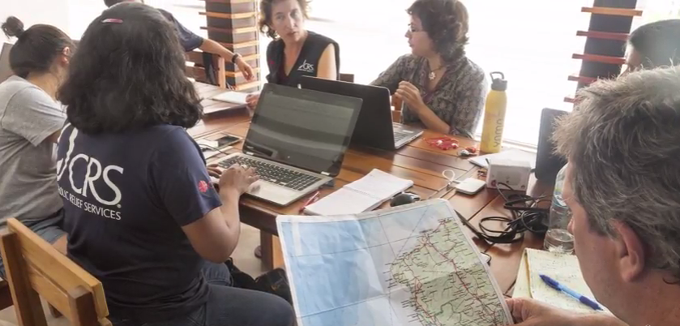
Temporarily Adapting Staff Policies
Staff policies during the emergency response may differ by location & staff role or category
Notes:
As you’re reviewing and temporarily adjusting your staff policies to address the emergency, remember that policies may differ by location and staff role or category. For instance, national and international staff sent to difficult field locations, seeing firsthand the damage done by a disaster, will likely be under more stress than those working in areas not directly impacted by the emergency. As a result, you might decide to provide these field-based staff with more downtime – through either R&R or compensation time policies.

Slide 17
Temporarily Adapting Staff Policies
Int’l CP Staff
CRS Short Term Assignment
Consultants
CRS TDYs
Volunteers/ Temporary Service
Nat’l CP Staff
If policies will differ:
Include all locations & all staff categories
Carefully consider what you are supporting & why
Clearly specify policies by location & staff role/category
Explain differences to the staff affected by the policies
Notes:
If a staff policy for the emergency response will affect various staff differently:
make sure that, in your discussions, you include all locations and staff categories -- the CP staff, both national and international, old and new; local volunteers; TDYs; staff on short term assignments; and consultants. Note that in somes cases, staff in another country program or the region may be supporting the emergency response in significant ways… the region should assist in considering staff care policies that may need to be put in place for these staff.
Carefully consider what you are supporting & why. Make sure your temporary policy will have the consequences you intend it to have, and will support the staff you are intending to support.
Clearly specify the policy by location & staff role/category, and
Explain any differences to the staff affected by the policy, to reduce any potential misunderstandings or tensions among staff.
In general, it is often best to have broad policies at the outset of a response, minimizing differences in support by staff category or location; more nuanced policies can be put in place over time…

Slide 18
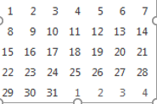
Temporarily Adapting Staff Policies
Share & equitably enforce the staff polices
Review & update the policies, as needed
review at minimum every 3 months
include staff feedback in the review process
if a new policy is more generous to staff, make it effective immediately
if a new policy is less generous, share changes with staff well in advance of the effective date
Notes:
Once you have set or updated these policies for the emergency period, make sure they are shared and equitably enforced across offices and departments.
One program manager, for instance, cannot refuse to allow his or her staff to go on R&R; and a per diem policy should not be enforced differently by each field office.
Given that emergency contexts are very fluid, you’ll need to review the policies on a regular basis & update them as needed. A review should be done, at minimum, every three months over the course of the response and recovery.
You should gather feedback from staff as you’re undertaking your reviews; it’s helpful to do exit interviews with TDY staff to capture their perspective as well.
And bear in mind - if you’re making changes that will make the policy more generous to staff, put it into effect as soon as possible. If the changes will be less generous, make sure the updated policy is shared with staff well in advance of the effective date, so that staff can mentally adjust to the new policy. Pay special attention to issues such as R&R, where people need to be making travel arrangements ahead of time.

Slide 19
Underlying Objectives
Speed & Effectiveness of Response
Safety & Security of staff, partners & beneficiaries
Notes:
As you’re making decisions and moving forward with implementing staff care support, remember to keep the speed and effectiveness of the response as well as safety and security in mind.

Slide 20
Resources
Headington Institute
http://www.headington-institute.org/
CRS Safe & Sound Manual
Emergency Field Operations Manual http://efom.crs.org
- EROS checklist
- HR section
Notes:
The Headington Institute website is an excellent resource on stress and personal resilience, while the CRS Safe & Sound Manual and Human Resources section of the Emergency Field Operations Manual can provide additional information on staff safety and wellbeing. The EFOM also includes guidance and templates for R&R and other policies typically put in place during emergencies.
And if you need more guidance or support, please don’t hesitate to reach out to the HRD!

Slide 21
w
Acknowledgements
With thanks to the Headington Institute
for providing the information & graphics on stress, stress management and resilience
Notes:
And we’d like to end with grateful acknowledgement to Headington Institute, for providing the information and graphics concerning stress, stress management and resilience, used in these staff care presentations.

