Slide 1

Operations in Emergencies:
Staffing Considerations
Notes:
Welcome to this introduction to staffing considerations in emergencies.
This presentation will give you an overview of staffing and recruitment challenges your country program may face during an emergency, along with guidance and best practices to help you address these challenges.
So, let’s begin…

Slide 2
Learning Objectives
Adjusting Operations Staff Roles & Responsibilities
Determining Staffing Needs
Finding Staff
Notes:
In this presentation, we’ll look at:
- adjusting operations staff roles and responsibilities during an emergency,
- determining staffing needs, and
- finding staff to meet these needs.

Slide 3

In Emergencies, THINGS CHANGE
…so be ready to adapt!
Notes:
The first thing to bear in mind is that in emergencies, things change… so you’ll need to be ready to adapt. This applies to your operations staff, as well as the rest of the Country Program team.

Slide 4
Adapting Roles & Responsibilities
  Responding to an Emergency often means:
    Many new temporary and longer-term staff, with high staff turnover
    Adjustments to supervision & reporting structures
    Streamlining operations policies & procedures
Notes:
From a staffing & Human Resources perspective – an emergency often means:
- bringing in lots of new staff – both temporarily and longer term,
- adjusting staffing and reporting structures, and
- streamlining policies, procedures and processes, including recruitment
to address evolving response and recovery needs.

Slide 5

Adapting Roles & Responsibilities
Senior operations
staff are
essential
for the planning
& implementation
of the
emergency response
Notes:
Senior Operations staff – such as the Head of Operations, the Finance Manager and the Admin Manager – will have leadership roles in the response. They will be the ones determining how to streamline policies & procedures… & they will be the ones finding good staff and supporting them in carrying out their roles effectively.
As such, these senior operations staff are essential for both the planning and implementation of the emergency response. They need to be involved from the outset, to ensure both that the response plans are grounded in operational reality and that the operations department will be prepared to expand their teams as needed to support the emergency response.

Slide 6
Adapting Roles & Responsibilities
An SMT staff member (usually the HoOPs) should have responsibility for ensuring:
    Regular reviews & updates of staffing and operations policies & procedures take place
    All staff are kept current on who’s responsible for what & the procedures for getting things done!
    Information is not lost during staff transitions
Security
Staff & HR
Supply Chain
Staff Care
Authorization Matrix
Finance
Notes:
Given the state of flux during an emergency, one of the country program’s Senior Management Team members - usually the HoOPs -- will need to take on additional responsibilities during this time.
The first is to ensure regular review and updating of the staffing and operations policies & procedures.
This includes putting security protocols and staff care policies in place, to support the safety, health and wellbeing of the staff in a high stress environment. It will also include the staffing structure and authorization matrix, as well as supply chain and finance procedures. The frequency of the review and updating process will often be high at the start of the emergency and can then be scaled back as the situation stabilizes.
This person will also need to ensure that all staff are continually updated on who’s responsible for what, and how to get things done. This is important as new people arrive and adjustments are made to policies and procedures! This information needs to be posted centrally – so everyone knows where to get the most current version.
And finally, they must also ensure that information is not lost when staff leave… this can be a major problem in emergencies, where TDY staff often don’t get a chance to have a long overlap with their replacement. Detailed, written handovers along with copies of files must be shared with the supervisor and the replacement, as well as other co-workers involved with their work.
For these last two issues -- setting up a sharepoint or Office 365 group, with a designated site manager, is often helpful for archiving staffing information, policy & procedure updates and handover documents… if this isn’t possible, other options need to be explored. Setting up a group email for those involved in the response is often useful as well, but will need to be regularly updated.

Slide 7
Adapting Staff Policies/Procedures
Specific to Staff Policies, the CP should consider:
  Instituting Hazard Pay and R&R
  Reviewing & updating Per Diem rates
  Reviewing & updating work hours
  Other support (e.g. lunch, transport, etc.)
These policies may differ by location and staff
  Clearly specify policies by location & staff type/level
  Provide clear rationales for any differences
  Ensure established policies are enforced equitably
Staff Care
Staffing & HR
Notes:
Specific to staff-related policies, the Country Program management should consider putting in place hazard pay and R&R policies, reviewing and updating per diem rates – as costs may have been affected by the emergency, updating work hours for the response and providing additional support to staff, such as meals or transport.
It should be noted that the emergency response may be affecting certain locations or staff more than others, and policies may therefore need to offer different levels of support. If this is the case, the policies must clearly specify support for each location and category of personnel, any differences must be understood by staff, and the policies should be enforced equitably. If not, it can cause resentment and conflict among the staff. These policies will also need to be updated as the situation evolves.
These issues are discussed in more detail in the Staff Care presentation in this series. Those who will be responsible for developing and updating staff policies should watch this presentation as well.

Slide 8

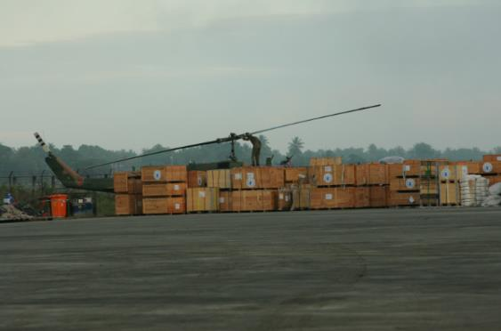

Staffing Needs
Emergencies often increase staffing needs significantly
Staff Up in Operations as well as Programming!
Notes:
Now let’s look at staffing and recruitment. Emergencies often increase staffing needs significantly. Emphasis is often focused on finding programming staff to support partners and carry out the response. Emergencies, however, usually significantly increase demands on operations staff as well, from supply chain and fleet to human resources, IT and finance.
These functions are essential for the implementation of the response and are often needed sooner than we think!
Your emergency response cannot move forward without adequate operations support. So staff up in operations, not just programming! And do it sooner rather than later.

Slide 9

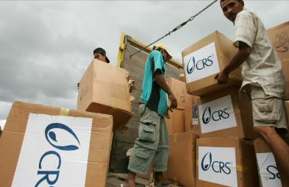
Staffing Needs
Consider the anticipated size & scope of the emergency programming…
    Types of interventions; cash/vouchers vs distributions… or both?
    Duration of response
    Partnership vs CRS direct implementation
Notes:
Staffing for the emergency should be based on the anticipated size and scope of the emergency programming, so consider:
What type of activities will you undertake and how many people will you try to reach? Will the response involve cash and vouchers, direct distributions of commodities, or a combination of both?
How long do you think you’ll be responding in the area – will it be a quick intervention for a few months, or will you be there for a year or more? And…
Who will do it -- are there partners available? If so, how much hands-on programming and operations support will they need? And if there are no viable partners, will CRS implement directly? In discussing this, it’s important to be realistic about the capacities of partners and the extent to which CRS may need to support them – especially in the immediate aftermath of a disaster. There are many different ways to work with partners and partnerships can evolve over the course of a response – if you need some more information on this, please look at some of the guidance on partnerships in emergencies provided by the HRD.

Slide 10
Staffing Needs
        & the structure needed to carry this out…
Partners
CRS Secondments
Main Office
Main Office
Field Office
District Field Office
Field Office
Notes:
You’ll also want to consider the structure needed to implement the emergency response. This will often depend on the availability of partners, as well as accessibility of the programming areas.
If there are strong partners who will be doing the direct implementation, you may just need to increase emergency staff in the main office to provide partners with additional technical support.
If partners do not have the capacity to respond on their own, which is often the case in a large emergency, you may need to either second staff or get involved in direct implementation.
If areas cannot be accessed from our main office, we may need to set up additional field offices to be closer to the response locations. In this case, additional operations staff will need to be brought in to manage and operate these sites.

Slide 11
Staffing Plan (Operations Example)
FUNCTIONS | Main Office | District - Level Field Office | Local Field Office | Seconded to Partner
Senior Ops Management
Supply Chain | Immediate need | Immediate need | n/a | Immediate need
Fleet
Facilities & IT
Human Resources
Finance
FUNCTIONS | Main Office | District - Level Field Office | Local Field Office | Seconded to Partner
Senior Ops Management
Supply Chain | n/a | Needed for 3-6 months | n/a | Needed for 3-6 months
Fleet
Facilities & IT
Human Resources
Finance
Notes:
Once you’ve determined the initial scope and structure of your response plan, you’ll need to start making a staffing plan. This can be done in stages. Start by focusing on immediate needs – covering the first 3 to 4 weeks.
To do this, consider all the functions you will need to carry out to fulfill the response plan for this period. Your staffing plan should include both programs & operations; in this slide, we’ll focus on operations staff as an example… The list should be expanded as necessary.
Then think about where these functions need to be carried out. For instance, if you will be doing a large commodity distribution program, where will you be buying most of these commodities and where will you need to warehouse them? You can then determine if you will need additional supply chain and logistics staff at the main office, a field office or seconded to a partner. You may need all three!
Once you have this basic idea of the functions you need to fill in each location, you can then refine the plan further, to determine numbers of staff and finalize specific job descriptions or scopes of work. Additional tools that may help you are on the Emergency Field Operations Manual (EFOM), in the Human Resources section.
Once you’ve gotten recruitment for immediate staffing needs underway, the staffing plan can be expanded to cover the next 3 to 6 months; subsequent expansion can then be done if the response and recovery will continue for a longer period. Your staffing plan will evolve over time and should be considered a living document.
And while this presentation focuses on operations staffing, don’t forget programming and field staff recruitment as well.

Slide 12
Staffing Plan for Operations
Senior Ops positions should never be left open during an emergency & are first priority for recruitment
Notes:
Senior operations positions... including the head of operations, Finance Manager, Admin Manager and Head of Office… need to be included in your staffing plan. You’ll need to move forward quickly with recruitment at all levels, but these senior operations should never be left open during an emergency. They will be your first priority for recruitment if any of the them are!

Slide 13

Staffing Plan for Operations
Estimate needs and put supporting equipment & facilities in place as quickly as possible
Notes:
As the staffing plan is being developed, you’ll need to ensure that steps are also being taken to provide incoming personnel with the support they will need to successfully undertake their role. An emergency usually means increased need for computers and communications equipment, work space, transportation and living accommodations. Estimate needs and put supporting equipment & facilities in place as quickly as possible. Don’t forget to build in a cushion, as needs may increase over time.

Slide 14
Finding Staff
CRS CP Staff
Act Fast + Be Flexible
New Recruitment
CRS Temporary Duty (TDY) Staff
Temporary Service Agreements
CRS Short Term Assignments
Volunteers & Day Labor
Consultants
Notes:
Once you have your basic staffing plan, you’ll need to find the people to fill the positions.
Bear in mind that you’ll need to act fast and be flexible during the start up of the emergency response. That means looking at all of your options for staffing, and using them as effectively as you can.
Staffing options will include:
Reassigning your country program staff to the emergency response, temporarily or, in some cases longer term
Bringing in temporary duty (or TDY) CRS staff. These staff can come from the HRD, the Region, and other Country Programs. They can typically stay from three to six weeks, though in some cases may stay longer or may be able rotate back if the response/recovery will be continuing.
Bringing in CRS staff on short term assignments. These are CRS staff who are not currently associated with another department or country program, and can often stay longer than TDY staff. Their contracts are slightly different than regular international country program staff, but are governed by the same in-country benefits policies.
Bringing in consultants. The HRD maintains a roster of emergency consultants, most of whom have worked with CRS in the past and have experience with CRS programming & operations systems.
Working with local volunteers and daily labor, who are overseen by CRS staff or TDYers. This is often a loose arrangement to begin with, but should always be documented and the relationship should be clarified as soon as possible if it will continue for longer than a few weeks. This is typically done through local Temporary Service Agreements, under which people are contracted to work with CRS on a short term basis to fulfill specific tasks. If we are providing anyone with payment of any kind (including a daily wage, per diem, transport or other “allowances”) on a regular basis, they should have a temporary service agreement, with the work and support arrangements detailed. It should be noted that those hired under consultancy or temporary service contracts should be supervised by a CRS staff member and they should not be given responsibility for managing staff, budgets or finance.
Last, but not least, there is the recruitment of new, longer-term staff for the emergency response and recovery.

Slide 15
Finding Staff
Act Fast + Be Flexible =
Use CP staff, TDYs, Short-term assignments, Consultants, Volunteers
+ Temporary Service Agreements
-------------------------------
Start Longer-term Recruitment
+ New Longer-Term Staff
------------------------------
Start Phasing Out Temporary Staff
Shock Occurs
Month 1
Months 2 & 3
Notes:
In the immediate aftermath of a shock, you’ll often start out using people who are already available. One of your main resources in an emergency will be the CRS country program staff. While it is important to continue with regular development programming whenever feasible, the emergency response usually takes precedence at least for the short term.
TDYers or consultants can also be brought in quickly. Depending on your needs, these staff can play general managerial and technical advisory roles, or can focus on very specific tasks such as developing new proposals. Bear in mind, though, that their ability to come into country may be slowed by visa requirements. You will need to be up to date on the visa policies and procedures for your country.
At the community level, you and your partners may start out relying on volunteers.
Within the first month of the emergency, an initial staffing plan should be developed and Temporary Service Agreements should be put in place to bring national staff and volunteers on board short-term.
If the response will be short – four months or less – you may be able staff it this way for the duration.
If you expect the response and recovery to go beyond four months, however, you’ll need to do longer term recruitment as well. This should be initiated as soon as possible. Current CRS regular staff and those working under temporary service agreements can apply for the longer-term positions; they are often the best equipped to fill these roles, as they will already be familiar with the context and CRS’ programming response.
Generally, you should be bringing in longer term staff and starting to phase out temporary staff during the second and third months of the emergency. Recruitment, however, especially for management and highly technical positions, can take a while – so continue to supplement your staff using the other options as needed.

Slide 16
Staffing Tracking (Operations Example)
Notes:
As you start putting staff in place, you’ll need to track which positions have been filled and for how long. A simple way of doing this is to develop a matrix, listing each of the emergency positions. You can link this to a calendar and fill in the information on staffing as it comes available. You can then quickly see how you are doing with your staffing and prioritize outstanding needs.

Slide 17
Staffing List
Position for Emergency Response
Location of Assignment
Contact Information (email, telephone, etc)
Start Date
End Date
Name
Notes:
It is useful to keep a detailed list of staff as well. At a minimum, the list should indicate each staff member’s position while working on the emergency response, location of assignment, contact information while in country, start date and anticipated end or departure date. This list should be updated and shared out with all staff whenever someone joins or leaves the emergency response.

Slide 18
Emergency Recruitment
Know & Comply with Local Labor Law
Post Job Descriptions ASAP
Shortlist & Streamline Testing / Interviewing
Reference Checks
Orientation & On-going Training
Notes:
When undertaking recruitment, there are various steps you should take.
First -- make sure you know and are complying with local labor laws! If you don’t, it can create huge problems down the line. CRS policies should always be in compliance with local law.
Next, you should develop job descriptions and advertise the positions as soon as possible. The job postings don’t have to be very detailed; the job descriptions can be refined further during the hiring process. The positions can be posted in multiple ways and locations, as applicable, to ensure a wide audience. You can post internally and externally simultaneously, if needed; if it is likely you will have good internal candidates, you may just need to post internally.
Shortlist, and then interview and test people, as appropriate. But do try to stream line these processes as much as possible. A very short test can tell you if someone is literate in a particular language or has the skills to prepare a budget. If, during an interview, it quickly becomes obvious to the panel that the applicant is not appropriate for the position, you don’t need to spend an additional twenty minutes going through the rest of the questions on your list; you can thank them for their time and move on to the next interview. For people that will be working as part of a team, consider doing group interviews with role plays, rather than formal one-on-ones – this can give you insight into each person’s social and communication skills, while also saving time. Also, if someone is not the best choice for the position they applied for, but was otherwise an excellent fit for the Country Program – see if another position might be more appropriate.
Reference checks are a must. Don’t skip these. And then provide on-boarding and training for the new staff.

Slide 19

Emergency Recruitment
Determine which jobs require previous CRS experience
Usually senior leadership & positions involving cash or commodity oversight
Notes:
As part of developing your job descriptions, you will need to determine qualifications. One of these should be whether previous CRS experience is required. It is often deemed necessary for senior leadership, as well as positions involving cash or commodity oversight.
For these positions, you’ll need to decide if you can reassign current CP staff for the duration of the response. This can cause tension with the existing development programs, which may be losing some of their most valuable staff. If this is not a viable solution, you have two options. One is to bring in CRS staff from another Country Program for the duration of the emergency. The other is to do external recruitment. This, however, means that longer term CRS senior staff will need to play a much greater oversight role.

Slide 20
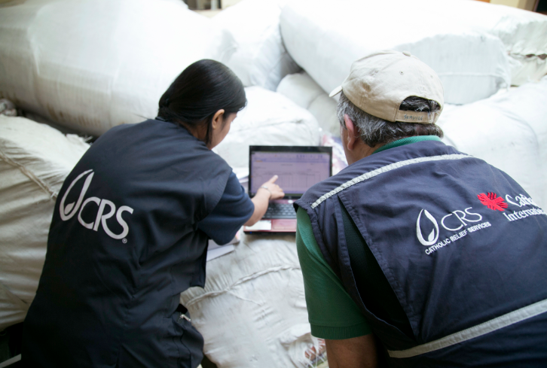
Emergency Recruitment
Provide on-going supervision & support for new staff!
Notes:
You’ll need to ensure on-going supervision and support for new staff. This links to the need for strong, experienced senior operations management, and your determination of which positions will require previous CRS experience.

Slide 21

Emergency Recruitment
Hire locally as much as possible
Notes:
Bear in mind that you’ll need to consider the locations you are hiring for and recruit locally as much as possible. For positions that require working closely with communities in the field, you’ll really want staff who know the area and are conversant with local languages and cultural norms. There may also be sensitivities around religion or ethnicity, which will need to be considered as well.
Exceptions may often need to be made for highly technical or managerial positions; for these staff, you may need to widen your candidate pool to find people with the necessary qualifications… but usually when recruiting, the closer to home, the better.

Slide 22

Emergency Recruitment
Put a premium on personal qualities
  motivation
  values
  willingness & ability to learn
  flexibility
  team spirit
Notes:
Given how stressful emergencies are, with teams often working long hours under difficult conditions, for most positions you should put a premium on the personal qualities of applicants, not solely on their technical skills – look at their motivation and values, their ability and willingness to learn, and their capacity to work well as part of a team. For many positions, if someone is bright, willing to learn and literate, CRS will be able to quickly train them in the skills they need.

Slide 23

Recruitment & Local Partners
Don’t steal partner staff
Support partner staff retention
Notes:
And as you’re hiring – remember that others will need staff too. You don’t want to steal key staff from partners and local authorities! Good people, regardless of which organization they’re working for, will be contributing to the emergency response. Think of ways that you can support these organizations in retaining and best utilizing these staff... consider things like secondments to provide support and training, or assisting the partner with instituting staff care policies for the emergency period.
If you do need to take staff, make sure that the partner is aware and agrees.

Slide 24

Underlying Objectives
Speed & Effectiveness of Response
Safety & Security of staff, partners & beneficiaries
Notes:
As you’re making your decisions and moving forward with your staffing plans, just make sure to be keeping response needs and safety and security in mind!

Slide 25
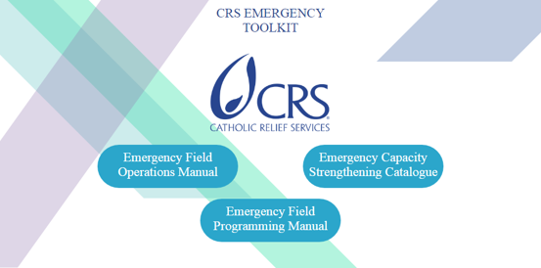
Resources
  Emergency Field Operations Manual (EFOM)
  EROS Checklist
  Human Resources Section
  http://efom.crs.org/efom
Notes:
The Emergency Field Operations Manual or EFOM provides additional guidance on recruitment you may find helpful – especially the Emergency Response Operations Set-Up (or EROS) checklist and the Human Resources section. The Human Resources section includes staff charts and generic job descriptions for various positions typically needed during an emergency.
You may also find some of the other presentations in the Operations in Emergencies series helpful. And if you need more guidance or support, please don’t hesitate to reach out to the Humanitarian Response Department!

